Slide 1
2
0
2
0

Slide 2
And now for the nominees…

Slide 3
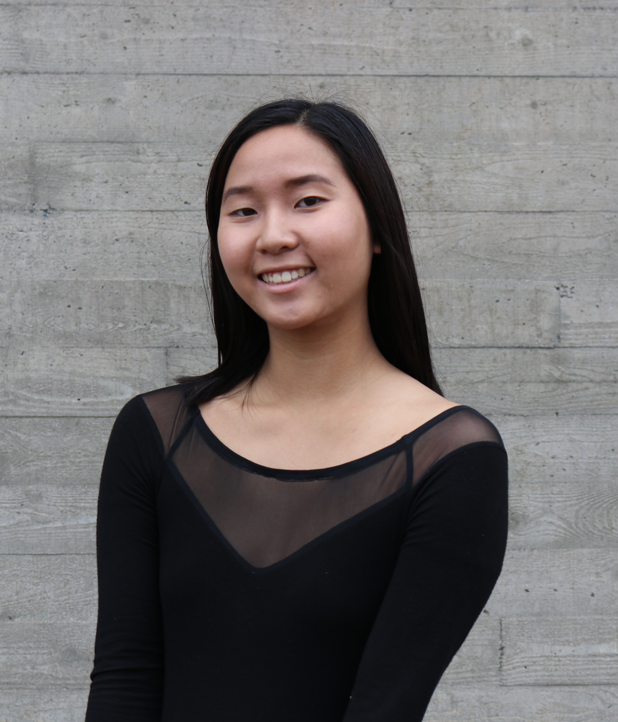
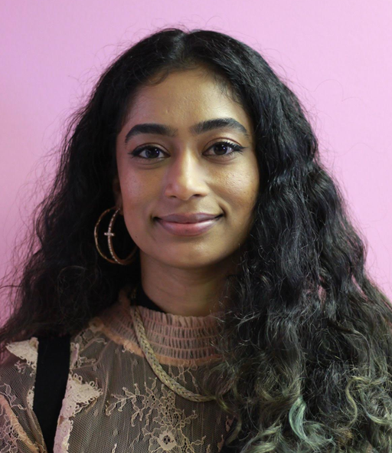
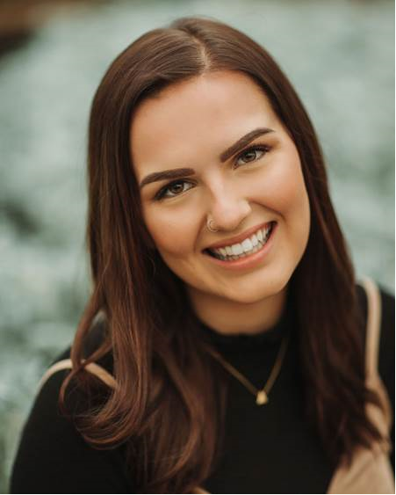
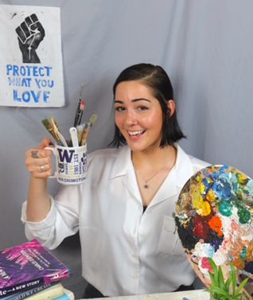
Award Nominees
Jacob Anderson
Ashley Creech
Serena Tran
Sanjevni Prasad
Kaelynne Nelson
Bee Elliott

Slide 4
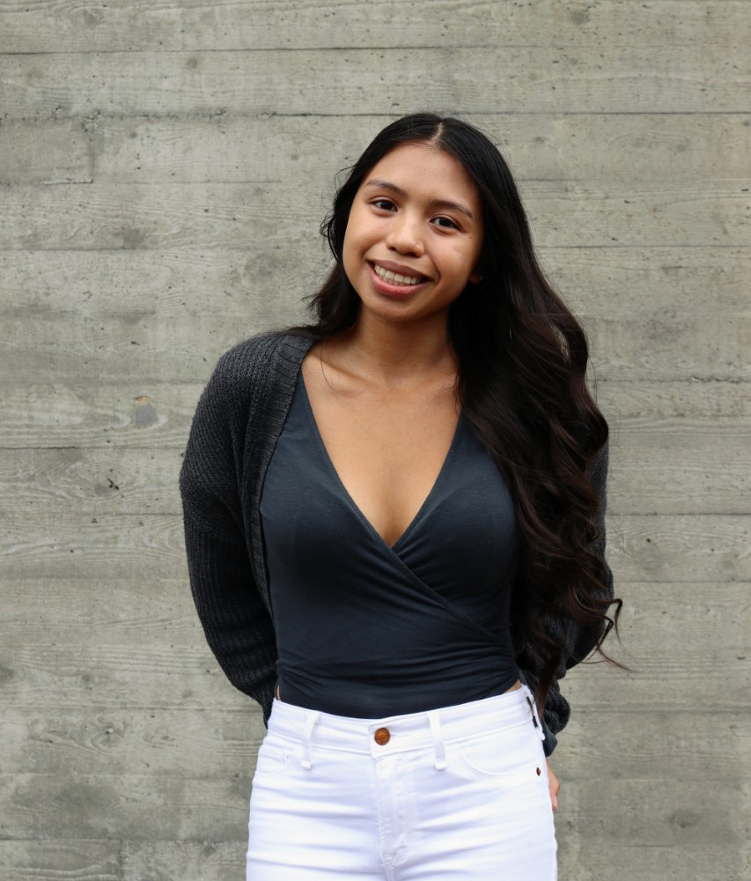
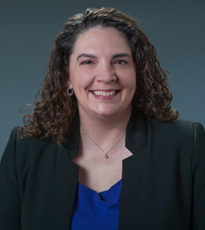
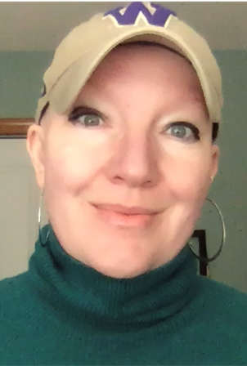
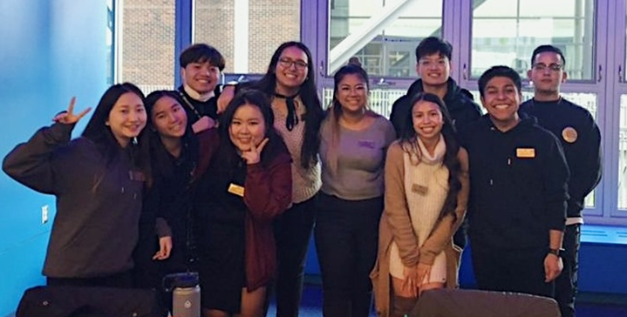
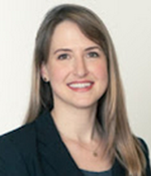
Award Nominees
Maria Martinez
Carla Christensen
Georgia Roberts
Campus Events Board & Social Justice Organizers
Katie Horowitz

Slide 5
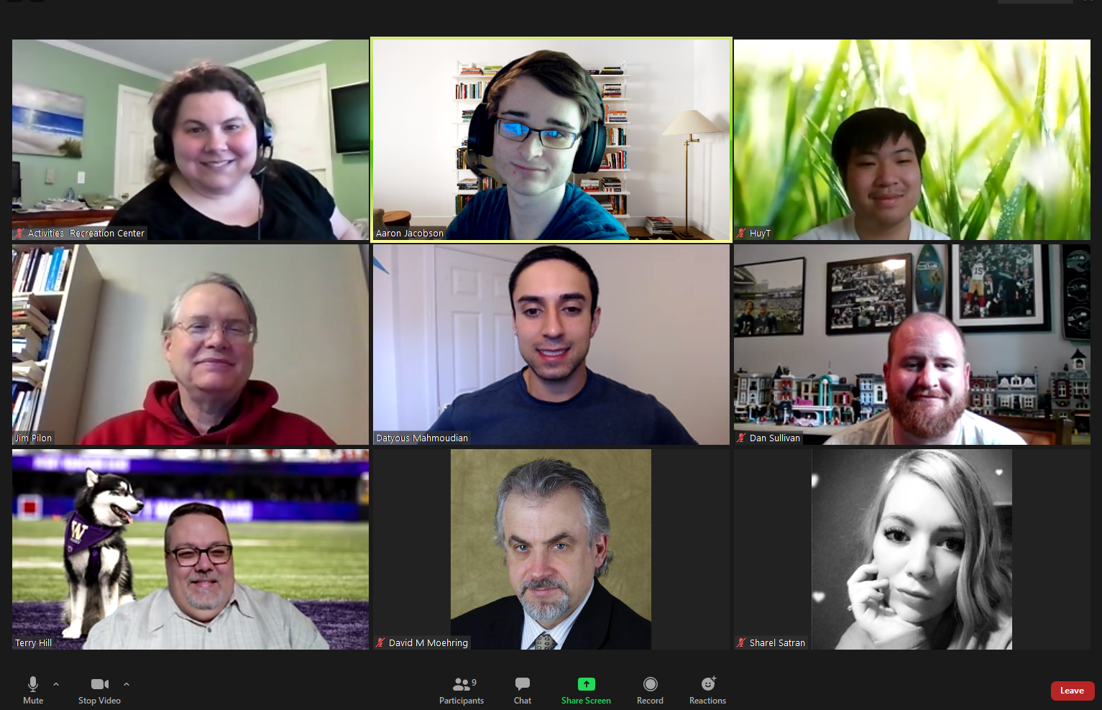
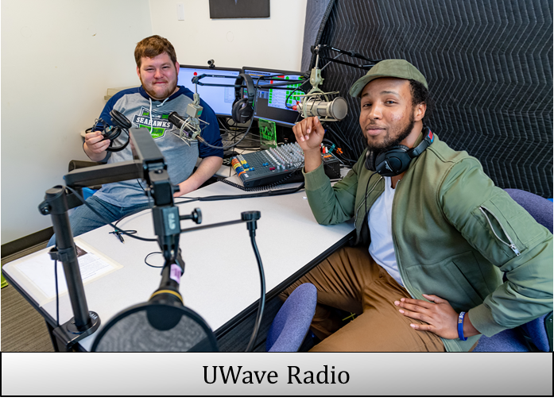
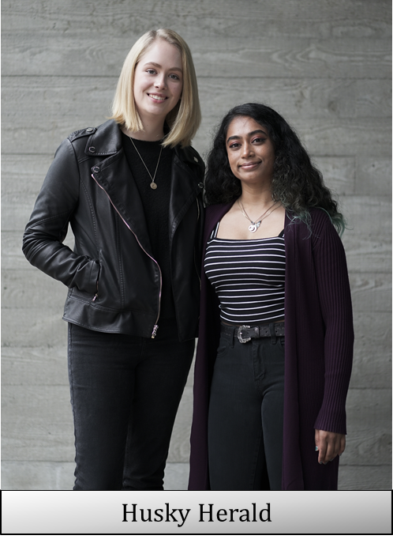
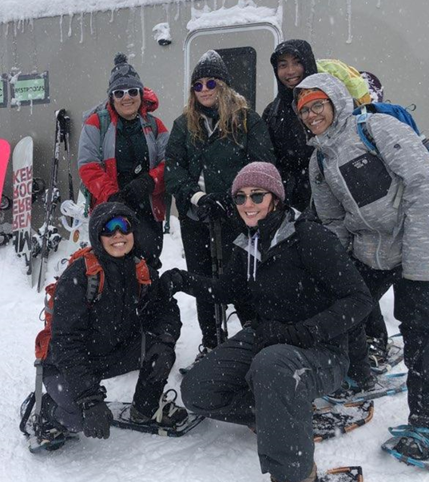
Award Nominees
Club Council
Student Technology Fee Committee
Outdoor Wellness Leaders

Slide 6
Outstanding Faculty Champion

Slide 7
Dr. Georgia M. Roberts

Slide 8
Dr. Georgia M. Roberts is an excellent faculty collaborator and instrumental in engaging students and enhancing their experience on campus. Dr. Roberts has collaborated with SEA Campus Events Board to bring a number of local artists to campus and is committed to helping our students engage in dialogue about music, art, and social issues, so that they have a truly meaningful and educational time at UWB.

Slide 9
Outstanding Student Affairs Staff Member of the Year

Slide 10
Carla Christensen

Slide 11
Carla is a brilliant student affairs professional and leadership scholar-practitioner who creates extraordinary experiences for students. Carla is exceptionally deserving of this award. When Carla was hired three years ago brought not only outstanding student activities but also knowledge of leadership theory and experience bringing theory to practice. That combination has been game-changing for our department and our division. She revamped the entire curriculum of our fall training for our department’s student leaders or organized it around the social change model of leadership. Carla’s contribution to leadership and to students is felt all across campus, whether that is in academic affairs (and soon to be the classroom itself with the upcoming leadership minor), with brand new students, and with current student leaders who will serve the rest of their peers with their programs.
Carla Christensen

Slide 12
Outstanding Student Leader of the Year

Slide 13
Kaelynne Nelson, Serena Tran, & Ashley Creech

Slide 14
Kaely is graduating with her bachelor’s degree in Business with a concentration in Supply Chain Management in Spring 2020 (she is also a graduate of Cascadia College), and is exceptionally deserving of this award. Kaely is a remarkably bold, accomplished, and brilliant student, and has indeed “made exceptional contributions to the quality of campus life at UW Bothell.” I have known Kaely through her involvement in ASUWB and SAF for two years. In this time I have found her to be a thoughtful student leader seeking to improve campus life for her peers and has sought out progressively more interesting and unique challenges.
Kaelynne Nelson

Slide 15
Serena is an exemplary leader and one who has done a great deal to provide meaningful, impactful, and memorable experiences for all UWB students. As the Chair for SEA Campus Events Board (CEB) and a member of Vietnamese Student Association (VSA) and Delta Sigma Pi (DSP), Serena has demonstrated great care, organization, and creativity in ensuring that her peers feel supported, empowered, and come away with some piece of learning, support, or tool. Serena has been essential in helping to enhance the UWB student experience and enabled not only CEB, but the Student Engagement & Activities (SEA) and the overall UWB, to meet our goals and promises we make to students who come here for outstanding education, memorable opportunities, and an inclusive community.
Serena Tran

Slide 16
Ashley is the Editor in Chief within the Husky Herald, UWB’s student newspaper. This is Ashley’s first student employee position on campus and she hit the ground running in rebuilding the Husky Herald newspaper to what it is today. She came into the position with limited experience in journalism and running a newspaper. But with active listening and learning the importance of journalism 101 and from her peers, she led the Husky Herald team in figuring out ways to reestablish the presence of a student newspaper on campus. This resulted in a newly rebranded student newspaper with qualities of what a newspaper should look like, which had many students, faculty, and staff excited about the new issues on campus.
Ashley Creech

Slide 17
Outstanding Contribution to Social Change

Slide 18
Maria Martinez

Slide 19
Maria is an amazing student leader who has time and time, again, proven her deep commitment to social justice, equity, education, and civic engagement. As the Social Issues & Awareness Programmer for SEA Campus Events Board (CEB), Maria has dedicated her last year to helping better educated and empower her fellow students. Because of Maria and her commitment to social justice, equity, understanding of the different issues impacting our students, and a desire for educating and empowering others, we have gotten some of the most meaningful programs on our campus, ranging from how to be an ally for lgbtqia+ community members to domestic violence awareness to understanding how mass incarceration impacts marginalized communities. She is truly a change agent and has helped many of our students understand how to make possible social change.
Maria Martinez

Slide 20
Outstanding Student Team of the Year

Slide 21
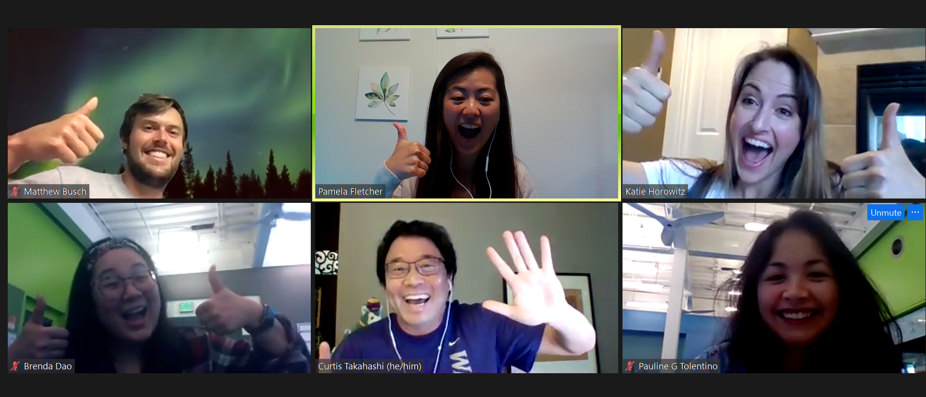
Committee pic
Awards & Recognition Committee
Matt Busch
Pamela Fletcher
Katie Horowitz
Brenda Dao
Curtis Takahashi
Pauline Tolentino

Slide 22
Student Technology Fee Committee

Slide 23
This award goes to a committee that went to great lengths to assure their fellow students had access to technology during the Covid 19 crisis. With their leadership, under the guidance of their Chair Aaron Jacobson, they were able to put laptops and hotspots in the hands of every student that needed it when campus went online this year. Vice Chancellor Sharon Jones had this to say to this committee: "I am so thankful to the STF committee for demonstrating great care for their fellow students along with tremendous organization skill to allow for an emergency allocation for laptops and hotspots for students at UW Bothell. Without their proactive approach to this challenge, our students would not have had access to the basic technology they need during this period of virtual instruction. So far, UW Bothell has maintained enrollment for spring quarter which is in a large part due to type of leadership that the STF committee provided in a time of need. Thank you STF."
Student Technology Fee

Slide 24
Outstanding Program of the Year

Slide 25
“Upsetting Bars: Mass Incarceration of Marginalized Communities” by the Campus Events Board and Social Justice Organizers

Slide 26
These two teams brought to campus an event unlike any other this year. They spent months planning every detail of their event. From the food that was served to what was displayed on screen throughout the event, every detail was intentionally chosen to achieve their objectives. This attention to detail is what made their guest's time on campus so profound, and inspired the deep learning so many attendees walked away with. For their "Upsetting Bars: Mass Incarceration of Marginalized Communities" program, congratulations to the Campus Events Board and Social Justice Organizer's teams for winning this year's Outstanding Program of the Year award.
Campus Events Board
&
Social Justice Organizers

Slide 27
Thank you all your commitment and dedication this year!

Slide 28
2
0
2
0

