Slide 1
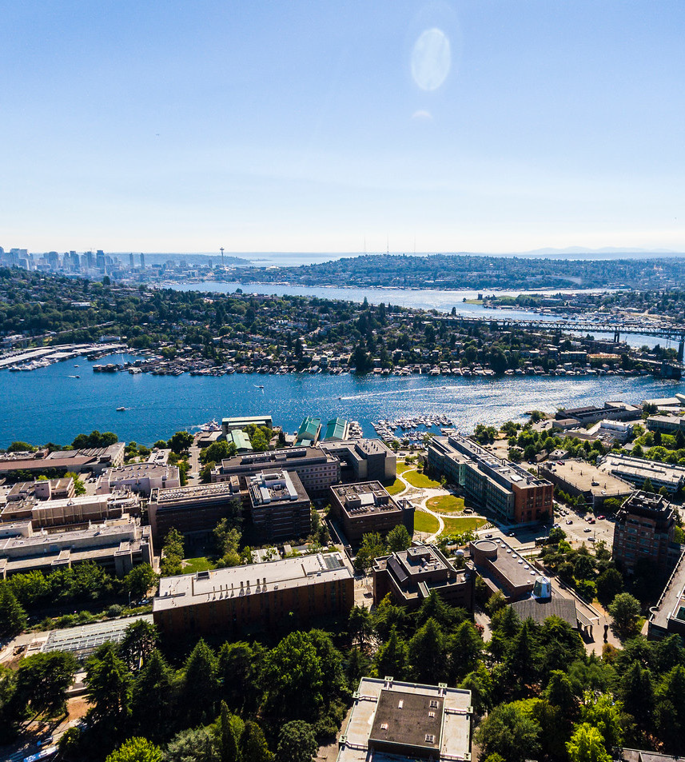
Innovation Grants Program – RFP Information Session

Slide 2
AGENDA
Welcome & Housekeeping
Land Acknowledgement
Introduction to EarthLab
Introduction to the Innovation Grants Program
Q&A
Closing comments from Ben Packard, EarthLab Executive Director

Slide 3
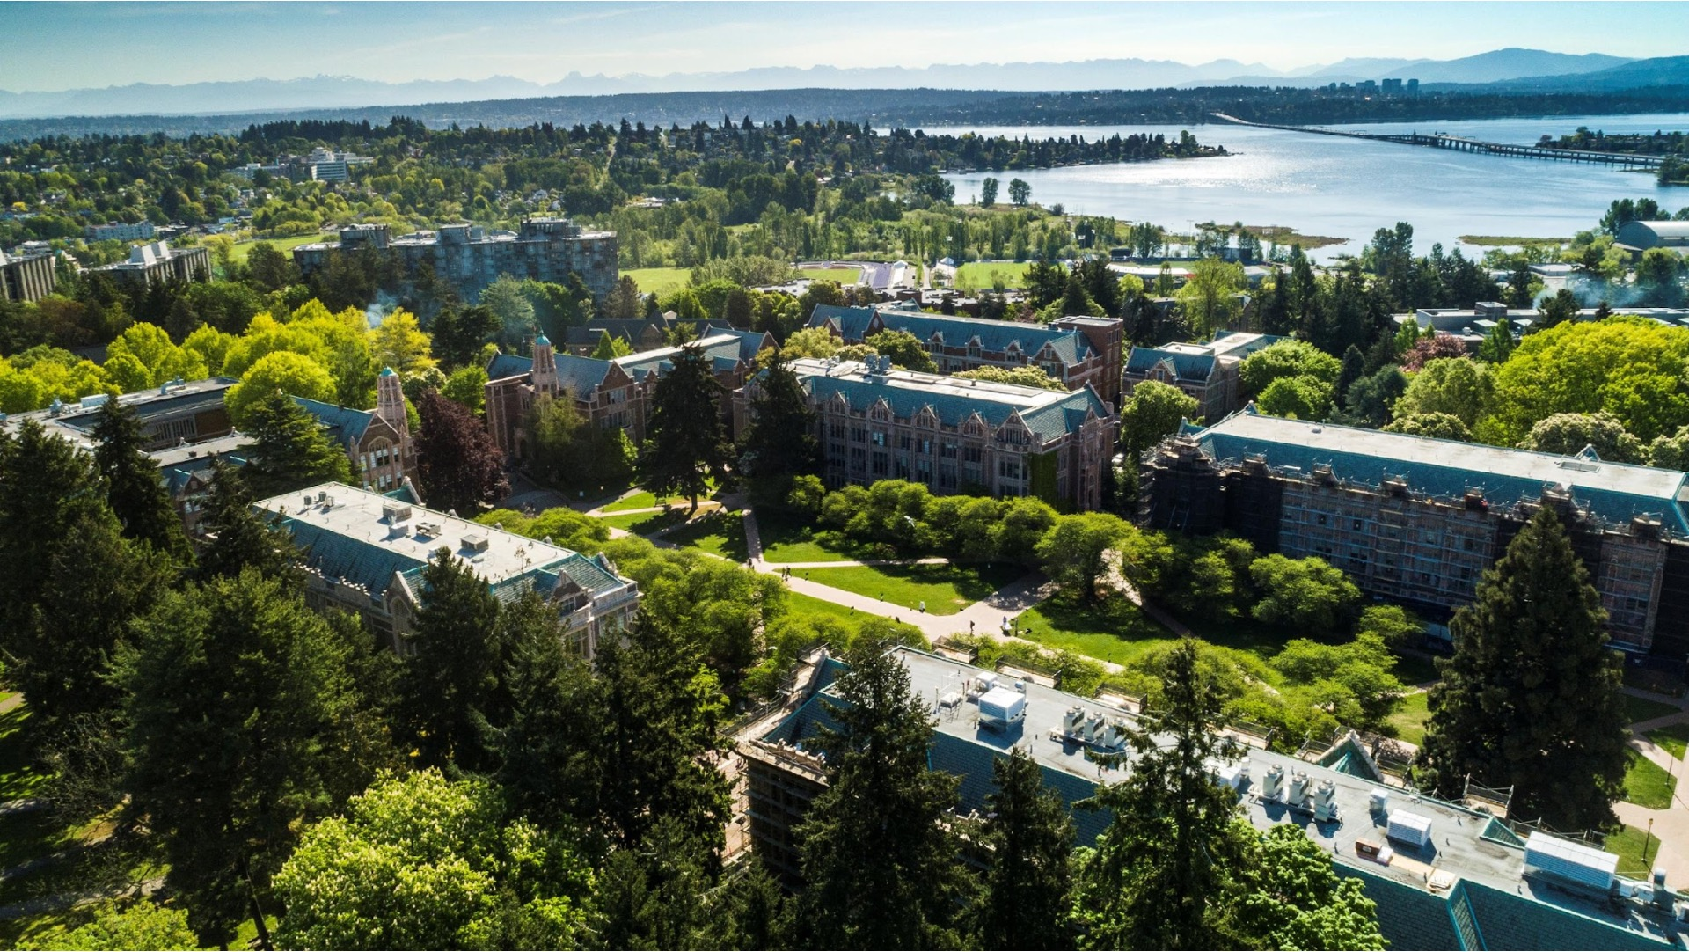
The University of Washington acknowledges the Coast Salish peoples of this land, the land which touches the shared waters of all tribes and bands within the Suquamish, Tulalip and Muckleshoot nations.

Slide 4
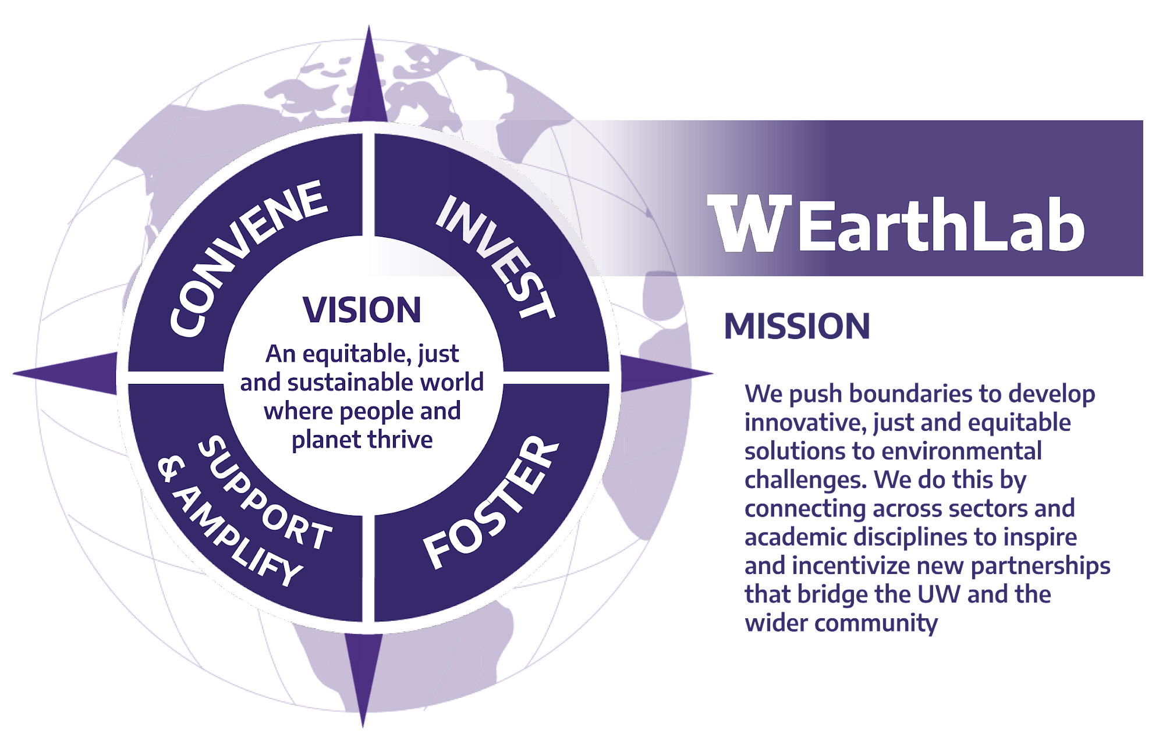

Slide 5
THREE STRATEGIC PRIORITIES
2021-2025

Slide 6
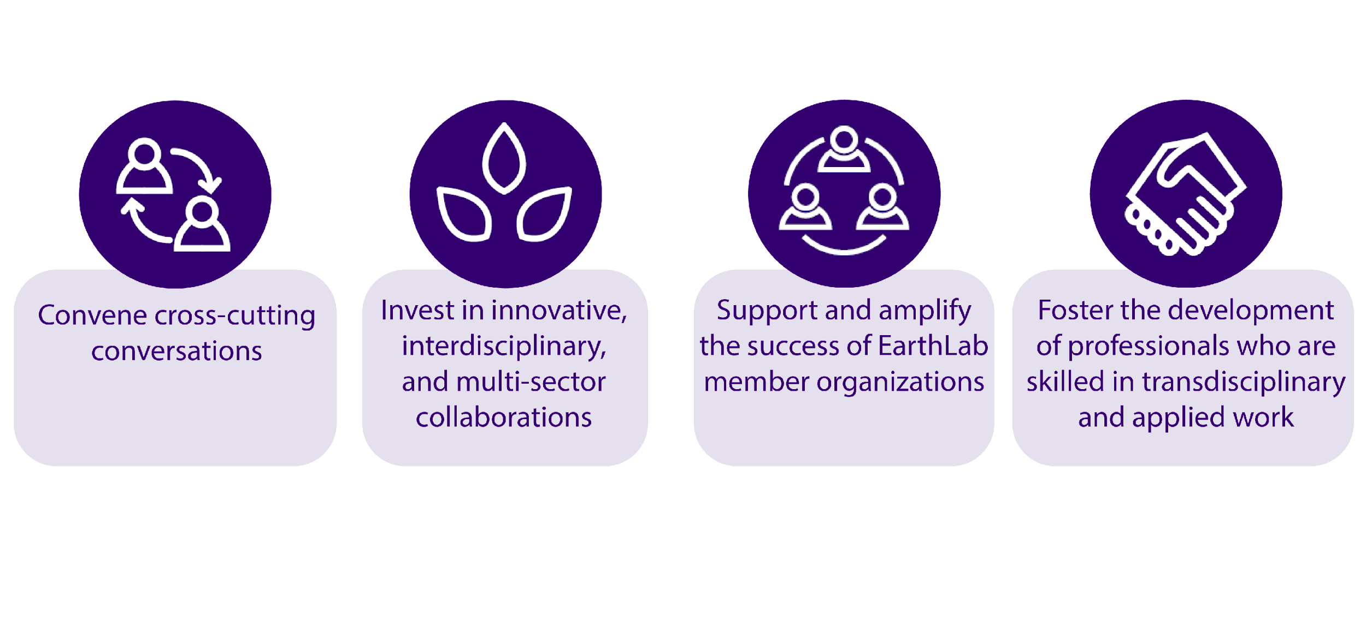
FOUR PRIMARY ACTION AREAS
$599,842
Total Innovation Grants Awarded

Slide 7
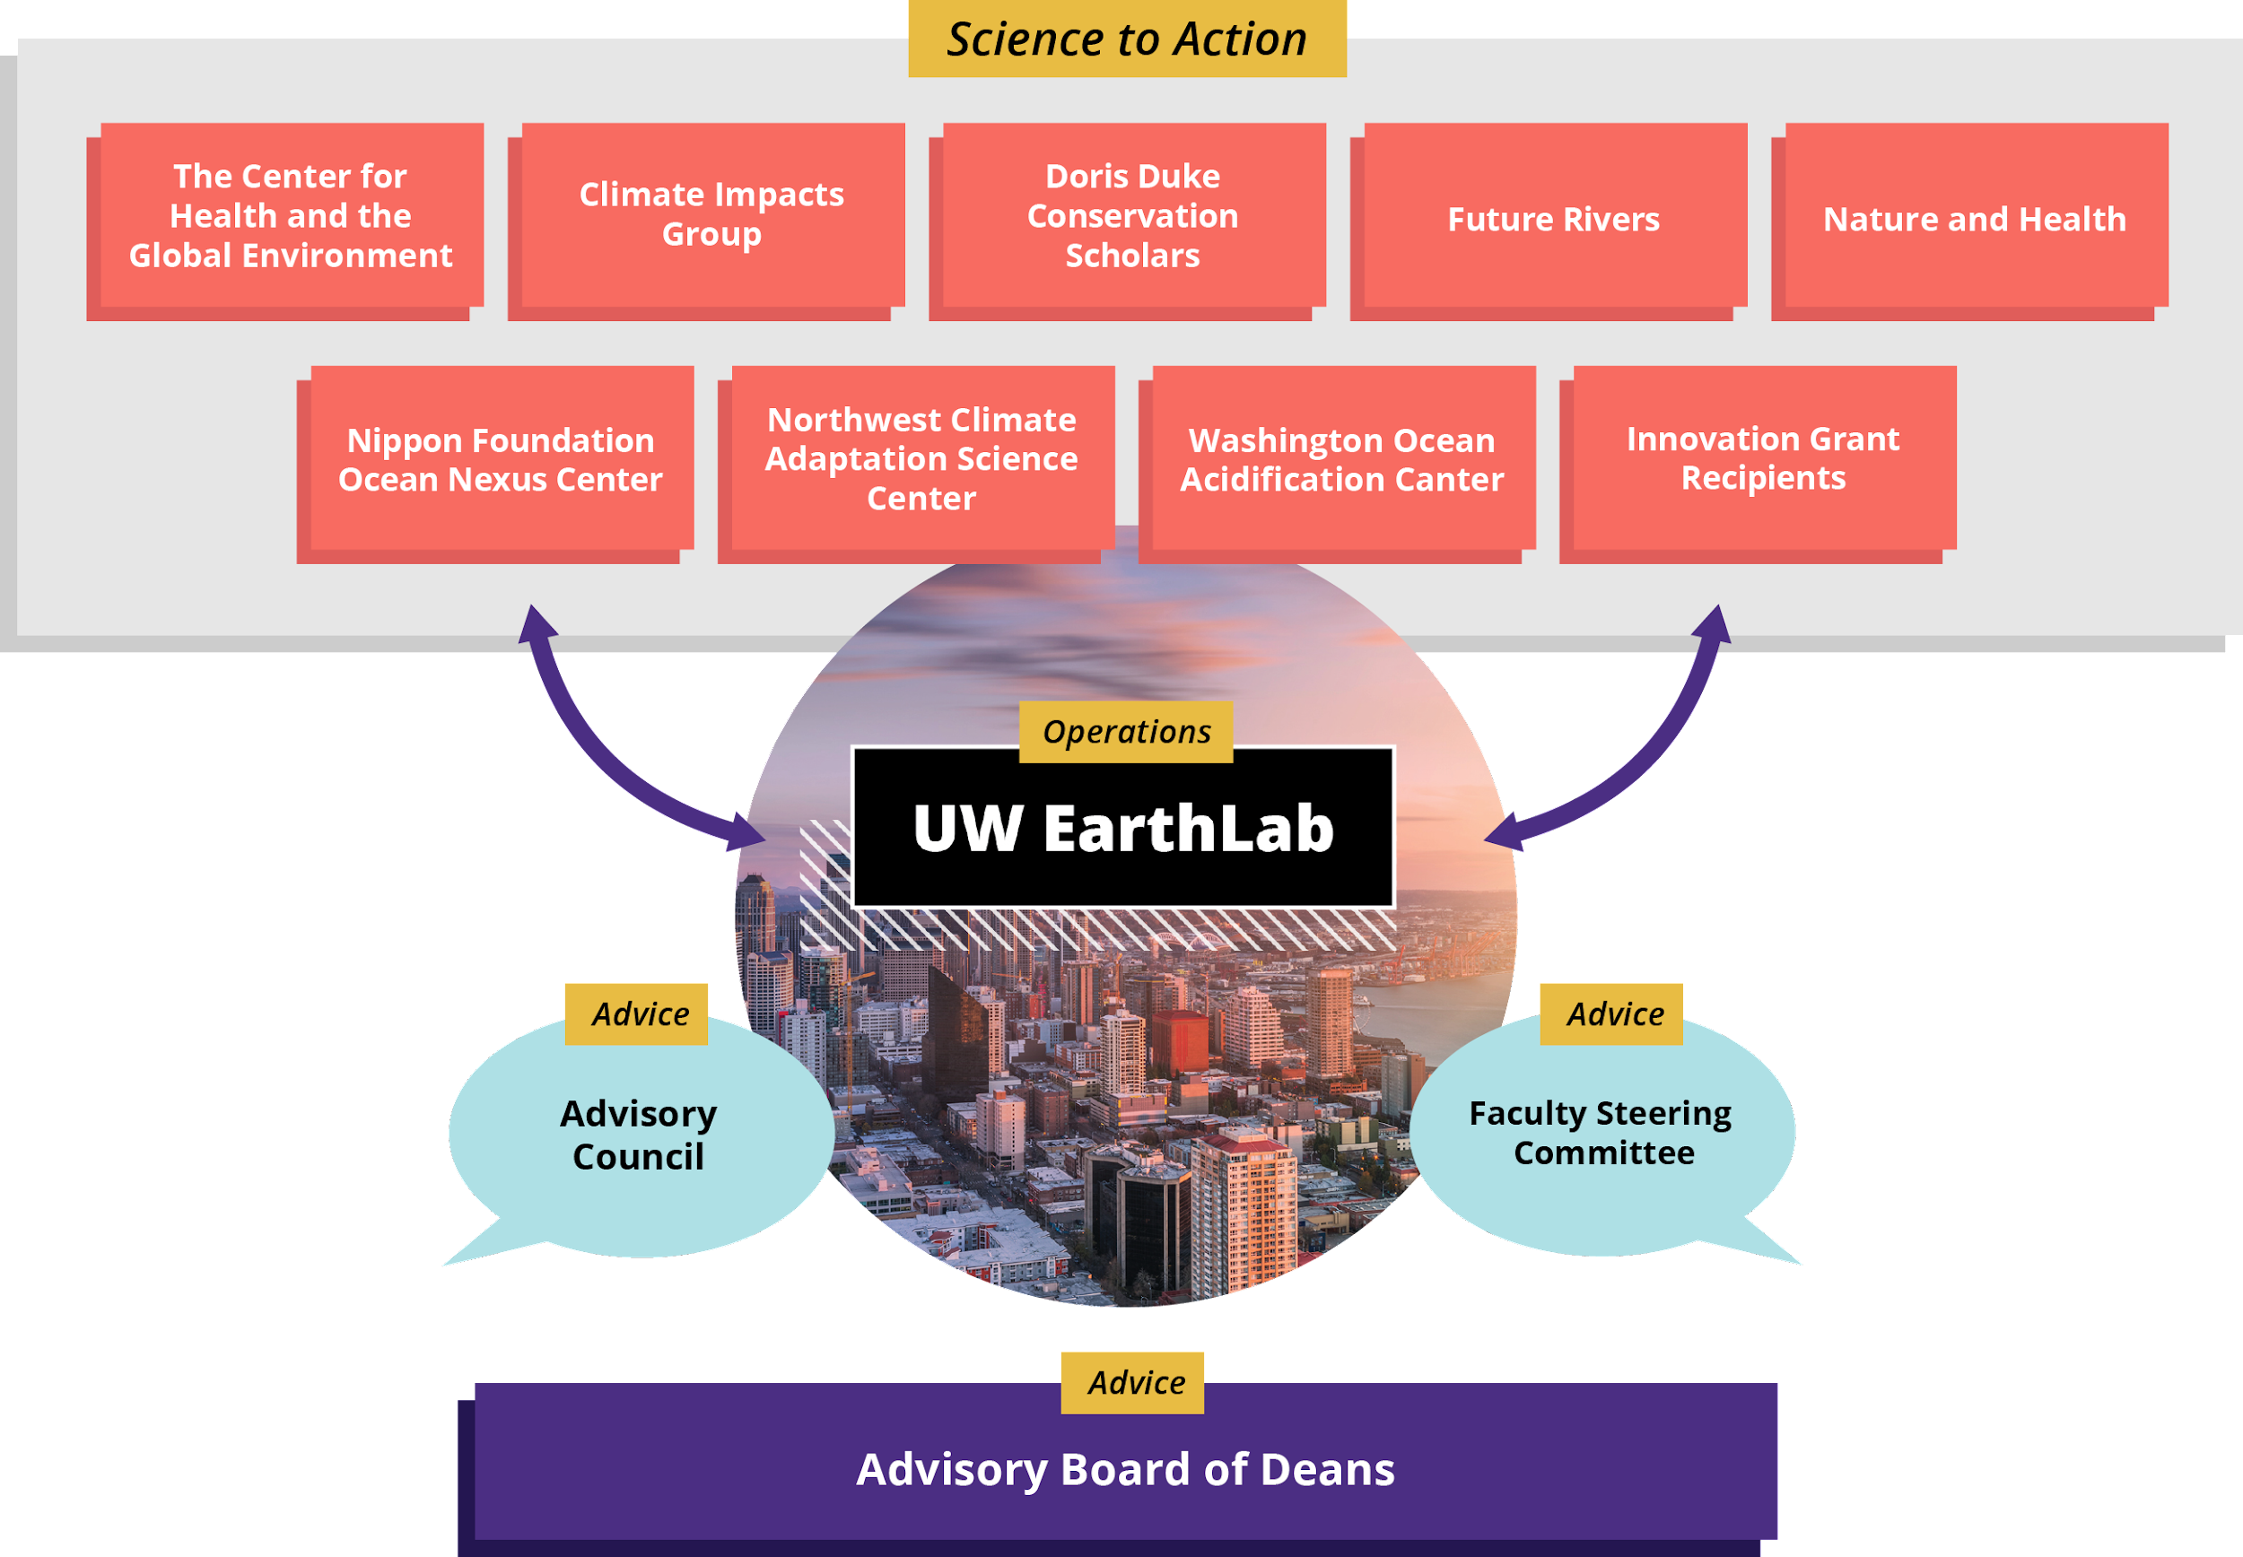

Slide 8
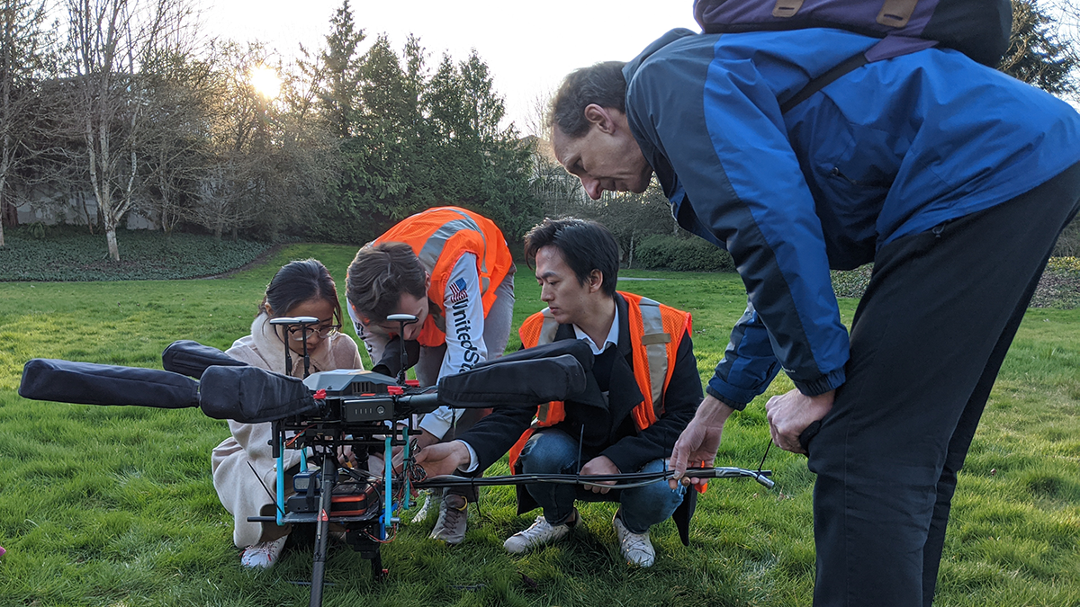

Slide 9
INNOVATION GRANTS PROGRAM
Maximum Funding Request: $75,000 per project over 17 months
Research at the intersection of climate change and social justice
Generate equitable and actionable science and knowledge
Co-creation and partnership between community and UW researchers
Interdisciplinary collaboration
Potential for growth of the project or partnership
Notes:
Total funding =$300,000 (Fund approx. 4 projects)
Generate new knowledge that can be used by the community and other stakeholders to mitigate or adapt to climate change and address intersecting social justice considerations
Science that is usable and used.
Partnerships between UW researchers and community (non-academic lead) co-define research priorities from multiple perspectives. Non-academic partners may include: personnel associated with/from a Tribe, community-led organization, non-governmental organization, city, State, or federal agency or a business.
At least two UW faculty or staff researchers (different discipline) (including one PI), and at least one undergraduate/graduate student or post-doc

Slide 10
REQUEST FOR PROPOSALS
Initiate a new research project that addresses climate change and intersecting social justice considerations
Projects may be local, regional, national or international
Team composition: At least two UW researchers (interdisciplinary & one with PI status), community/non-academic partner(s), UW undergraduate or graduate student(s)/postdoc(s).
Allowable expenses: personnel, travel, services, & supplies
Innovation Grant Cohort Meetings & Reporting Requirements
Notes:
This year the focus is more narrowly defined for research to address climate change (adaptation or mitigation). Examples (but not limited to) strategies to mitigate or adapt to climate change, impacts of climate change on people: food insecurity, health & safety risks associated with extreme heat, displacement due to sea level rise, economic impacts of climate change; policy innovations that center community perspectives
Past projects funded include projects in Seatac, Alaska, Peru, and Madagascar.
Team composition. PI responsible for ensuring compliance with all applicable federal, state, and institutional requirements. (Not under the Office of Sponsored Programs)
Must follow UW policies.
At least 3 meetings. Opportunity to network, skills development, provide project updates. Final report (no more than 2 pages)

Slide 11
CRITERIA
Reflect issues at the intersection of climate change & social justice
Clearly defined research questions and research aims
Co-leadership from community or non-academic partners & researchers
Novel mix of disciplines
Meaningful involvement of the student(s) or postdoc(s)
Clearly defined deliverable(s)
Clearly stated goals for sustainability or growth of the partnership or project
Notes:
Proposals will be evaluated on the following criteria:
4. For example art, ecology, policy, engineering and health
6. Deliverables: Immediate impact for community or non-academic partners. Examples: report/interactive website/podcast to share findings, community workshops
7. Sustainability: potential to persist and grow? Commitment to the partnership beyond the scope of this grant? Potential to obtain external funding to sustain the work? Project visible and understandable to various stakeholders? Relevant for multiple communities globally?

Slide 12
LETTERS OF INTENT (LOI)
Letters of Intent due January 27, 2022 @ 5:00 PM PT
Google Form Submission:
Team composition & roles
Funding requested (max $75K)
Attach LOI. Two page max. Single-spaced, no less than 12-point font, including figures
Attach up to 3 single page letters of support from community/non academic partners
Notes:
Last year 43 LOI submitted last year. 14 were selected to submit full proposals. 4 were funded. Full proposals due March 22nd, 2022. Awards announced April 2022.

Slide 13
THANK YOU
If you have follow-up questions, please email us at elgrants@uw.edu
Drop-in Zoom office hours every Wednesday 12:30 PM - 1:30 PM PT
https://earthlab.uw.edu/grants/apply/
Notes:
Link to Zoom office hours at the bottom of the Apply Now webpage.

