Slide 1
Activity scope TEMPLATE
PROJECT NAME: |  |  |  | DATE:
PROJECT DESCRIPTION:
Goals:
PROJECT START DATE: |  | PROJECT END DATE:
PROBLEM TO SOLVE/OBJECTIVE: |  | DELIVERABLES, METRICS AND TIMELINES:
TEAM MEMBER NAMES
Executive Sponsor(s): |  | Team Members:
Project Leader(s): |  | Facilitator(s):
 |  | Review Team if needed:

Slide 2
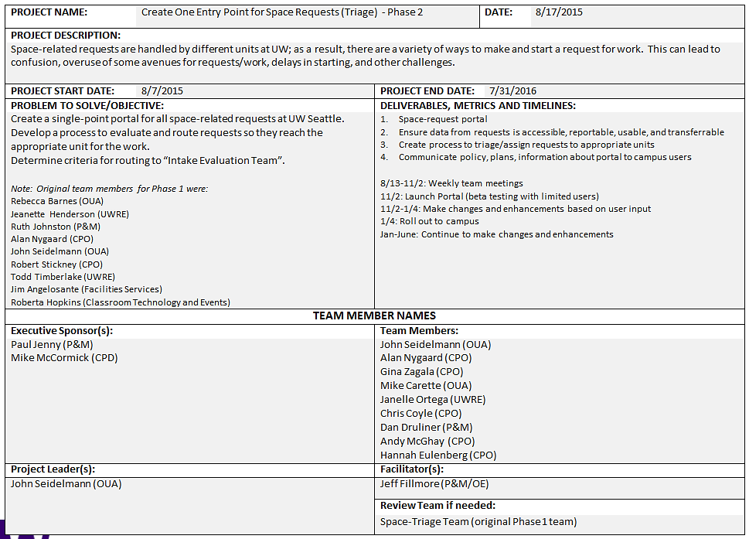
ACTIVITY SCOPE EXAMPLE

