Slide 1
Relationships Matter
Navigating the College Transition
Ann Ellis, MS, LMHC
Amy K Paulson, MSW, LMHCA
Trevor Taone, PhD
Counseling Center, UW1-080
Notes:
[Introduce yourself, your position at the UWB Counseling Center and what you enjoy about your work…and a connections you could make to remembering your freshman year, being a parent etc]
Today we’re going to explore how you, as parents, caregivers and family members, can help support your students during their transition to college.
[Normalize parent experience] For many of you today you may have never attended college, perhaps attended college in a different country or it was a long time ago since you attended…a lot has changed. It’s important to understand the experience our current incoming students face as they begin their college experience.
Most importantly, I want to remind you that you play a large role in your student’s life and their adjustment to college.

Slide 2

“
Notes:
[Next photo slides are intended to go slowly and evoke pathos as they are shown]
Humor me as we take a walk down memory lane for a minute…
Can you remember back to when your child was an infant, and you supported them as they learned how to walk?

Slide 3

“
Notes:
You held them and cared for them….

Slide 4

“
Notes:
Bathed them…

Slide 5

“
Notes:
Helped feed and nourish them…

Slide 6

“
Notes:
Taught them family tasks…

Slide 7

“
Notes:
Encouraged their interests…

Slide 8

“
Notes:
Supported them while they were courageous and learned new skills…
Starting college is a milestone. It begins a new season of life and we invite you to think about your job as a parent or caregiver in a new light. Your role as a parent or caregiver is still enormously important, but it is shifting to be less about managing directly and more about coaching and cheering your student on from the sidelines.

Slide 9
Overview
Transitions for students
  Academic
  Social and emotional adjustment
Transitions for parents, caregivers and families
  Changing norms
  Social and emotional adjustment
Tips to support your student
Resources and Q & A
Notes:
We believe this session is important because we know how foundational family relationships are and we want to support and equip you as your role is changing with your student.
Parent orientations are created to help families:
understand the college experience,
reduce anxiety,
learn how to support their student’s independence and growth.
As we look at our time together, here is an overview of where we are headed today:
1) First we will cover academic and social emotional transitions students face in their thinking and behavior as they adjust from high school to college
2) We’ll talk about some of the transitions parents, caregivers and families need to make as things change with your student
3) I’ll talk you through some tips for effectively supporting your student as they begin their college journey
4) Then we’ll wrap it up with some resources that might be helpful and I will leave some time for a brief Q & A

Slide 10
Transitions for Students - Academic
Changes from H.S. | New growth & strategies
Increased workload | Study effectively
Less check-ins | Keep self on track and paced
New professional experiences | Relationships with professors Groupwork
Less structure with time | Scheduling & learning to balance
Environment | Commute, roommates, meals
TIPS:
Develop positive relationship with challenges and failures
Ask for help
Notes:
Let’s begin with the academic transition your student is about to go through and how things will be different than high school.
Students are going to have an increased workload at college. College courses often involve a lot of reading and writing assignments, which can be labor-intensive. They will need to learn which assignments are worth doing with more care, which exams need more study time, etc.
Secondly, they will face less consistent check-ins and with their academic workload. Often in college there are fewer smaller daily assignments and larger projects that span weeks or months that students are expected to be working on.
Third, they’ll be facing a number of new professional experiences, like learning when and how to appropriately communicate with professors, how to work cooperatively in team situations and resolve group conflicts without an adult stepping in.
In addition, there is less structure in college. Students are responsible for their own time management, and it will take a while to earn how to balance school, work, family, health, self-care, etc. Some of these skills many of us are still working on… Furthermore, in a quarter system, it doesn’t take much to fall behind but it takes a lot to catch up.
Students will also face environmental changes. Many students will be commuting daily via car or buss and faced with getting used to a new campus buildings and spaces. Many students might be living on campus in a residence hall or living in an apartment away from home for the very first time. They are learning to manage their space in new ways, new roommates and take on chores for daily life while also completing their academic schoolwork.
A few additional tips to leave you with:
Another opportunity for growth freshman year is to developing a positive relationship with challenges—and failures. This enables students to build the emotional resilience that will serve them well in their future, postcollege life. There’s a good bit of research that shows that that learning how to fail and being good at failing can be more beneficial than learning how to succeed and being good at succeeding. Failing well means you’re going back to the problem, using each failure as helpful information for the next try, and you’re learning to persist. Students who do this learn not to be afraid of failure, which means they try more things and reach a little higher. What this means for you as a parent or caregiver is that you need to let your student struggle a little bit and resist that urge to rescue them. That’s hard and it can hurt, but it may be in your student’s best interest. If they learn not to fear failure, they can be more confident in themselves and their ability to solve problems.
Asking for help. Often students think they need to do everything on their own or it displays weakness to ask for help. There are many resources available on campus. Encourage them to take charge of their new life and to take advantage of these resources as needed.

Slide 11
Transitions for Students - Social/Emotional
Identity development
Diversity can be exciting and challenging
New relationships
Confronting myths
  “High School was easy so college will be, too!”
  “These are the best years of my life”
Notes:
College years are a period of social and emotional growth for students and full of adjustments. As a new college student, they will have a new level of independence and autonomy, which might be new to both your young adult student and you as the parent/caregiver.
Your student will be tackling things like:
Identity development. They will be leaving behind what’s familiar and forge their own path as they step into adulthood. They will be leaving a familiar environment, support networks and identities. That can be fun and exciting, but it can also be intimidating and kind of scary.
Diversity can be exciting and challenging One of the unique things about our campus is that we have a diverse student body and our students themselves have built a campus culture around social justice values. Being exposed to new and different people, belief systems, ways of thinking, etc. can be beneficial, but also complicated to navigate. Just like you and I have had to learn how to interact respectfully with people around us we might be different from or disagree with, our students our students are invited learn to do the same but with a lot less life experience.
New Relationships are being built with friends, peers, romantic partners, roommates, coworkers, faculty and staff. On any given day freshman year, students are learning how to network, how to make friends, how to date, how to successfully resolve conflicts and how to appropriately stand up for themselves.
Lastly, often students have unrealistic expectations of college. At times family has perpetuated these ideas or maybe media.
“High School was easy so college will be, too!” We see students who did well in high school but find it difficult to make the jump to university level work. They’ve built a lot of their identity around being the smart kid and they don’t know who they are if they’re not the smart kid.
There can also be an American expectation that college will be the “best years of your life.” This puts a lot of pressure on students facing everyday challenges. In addition, for students commuting to school (which on our campus are many) they are only here a few hours a week for example, and their experience may look different than other friends at different colleges.

Slide 12
Transitions for Parents & Caregivers
Changing norms
  Renegotiating rules and expectations
  Navigating finances
Social/emotional adjustment
  Balancing independence, connection, and support
  Changing family identity
  Changing personal identity
Self-care
  Remember healthy habits
Notes:
There will be transitions for parents/caregivers and family members as well…it’s important to remember it’s not only your college student who is in a changing developmental stage.
A lot of family norms are likely to be changing as parents and children adapt to new schedules and new demands on time and attention.
Adjusting rules and expectations is usually necessary, and this can cause some tension until the family unit as a whole can settle into the new normal. Remember this is a temporary period of adjustment and it will balance itself out as your student learns to balance their obligations.
Managing finances may shift as your student becomes a college student. Make sure to have conversations regarding your expectations and work on fiscal responsibility with them.
You will also have social/emotional adjustments.
Parents and families undergo emotional adjustments, too. Some parents may be looking forward to an empty nest or a more independent child, and some will miss having their kids around the way they used to be.
Your identity as a family unit may be changing as well but remember that you can help it change in positive ways if you keep lines of clear communication open.
Some of you may wonder “Who am I?” as your parenting role shifts and enters a season of redefining what you want to be about.
Don’t forget Self-care!
Please make sure to take care of yourself during this transition. What are some healthy habits you can lean into or re-introduce into your life to help support yourself?

Slide 13
Tips for Healthy Transitions
Expect ups and downs
Be creative about staying connected
Use clear and open communication
Empower students to seek their own solutions
Be aware of when your student needs help
Start looking forward – adult child relationship
Notes:
TIPS for supporting healthy transitions:
Expect ups and downs. Remember that your experience of college or early adulthood is likely pretty different from the world your student is dealing with. There are going to be things you don’t understand or aren’t familiar with. Growth isn’t linear. Cheer on their effort!
Be creative about staying connected. Times that helped you stay connected (like eating breakfast together) may not work anymore, or for those of you
with students living on campus or in an apartment, you may only see them sporadically…so you need to ask yourself what might work now? Family group
chat? You can still text a door dash gift card to show you see their hard work or drop off a home cooked meal? You might need to ask and brainstorm
together what might work.
3. Use clear and open communication. Many short conversations and checking in on things might be more helpful than long conversations.
We have mentioned this one already, but here we are again: Empower students to seek their own solutions- Avoid rescuing your student, focus on resilience. We touched on this earlier, but failure is a part of learning and building success, how can we as families model humanity and reframe that struggles also offer growth even if at the moment it feels like not passing a class is the end of the world.
And lastly, you have a very unique and special relationship with your student. Be aware of when your student needs help. If you’re noticing a significant
change in your student or you’re worried about their stress level, or something just seems off, feel free to take action. Talk with your student, get advice from
family members or another adult, or reach out to someone on campus to share your concern. It is important you know the difference between what stress
and distress looks like for your student. There are a lot of folks on campus who are here to help and services to come alongside your student.
Finally, here’s a good time to think about what you want your future relationship with your adult child to look like. Do you want to build mutual trust and respect while also offering independance? Are you planning on launching the next phase of your life now that your student is more independent? Whatever your goal is, think about how you can lay a foundation now for your relationships with your adult child…what do you want it to look like when they are 25 or 35?

Slide 14
Campus Resources
Health and Wellness Resource Center (HaWRC)
  Basic Needs Program
  Husky Pantry
  Health Education Programming
Violence Prevention and Advocacy (VPA)
Activities and Recreation Center (ARC)
  In-person and virtual work out classes
Student Activities and Engagement
  Activities and opportunities to connect with fellow students (In-person and virtual )
  Clubs and organizations
Care Team www.uwb.edu/studentaffairs/
Notes:
Campus resources that might be helpful
Health and Wellness Resource Center
Examples: like signing up for public benefits, accessing food pantries or utility assistance, creating a budget, filing their taxes, cooking healthy, and all kinds of other things. We also have a food pantry and food available for pick up along with sexual health and menstrual products.
Violence Prevention and Advocacy office
In the unfortunate event that your student experiences relationship violence, stalking, sexual harassment, or sexual assault, we have staff who can assist your student in making sure they’re safe, helping them look at their options for how to proceed, and providing support throughout their recovery.
ARC
The ARC includes our gym, fitness classes, gaming, study spaces and intramural sports
Student Activities and Engagement –SEA
Social events in person and virtual, clubs and organizations – a very active organization on our campus
Care Team
An entity parents, faculty, staff, students can reach out to when they have a concern for a student's well-being. It could be academic, emotional, financial, health etc. The Care Team can come alongside students to help match them with on campus or off campus resources.

Slide 15
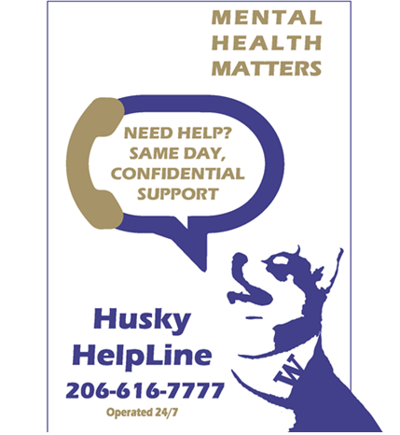
Counseling Center Resources
UW Bothell Counseling Center
https: www.uwb.edu/well-being
  Individual mental health counseling (in-person/telehealth)
  Group Counseling
  Case Management
  Neurodiversity Consultation
  Psychiatric medical consultation
  Drop-in crisis counseling appointments
  during the academic year (M-Th 1-3 pm)
Husky Helpline - 24/7 crisis Call 206-206-616-7777 to speak to a counselor
Notes:
Counseling Center Resources:
We provide individual mental health counseling to all UWB students who are currently enrolled.
Brief therapy- around a 6 session limit and most students find they are doing better after that
We have staff that in addition to English speak Spanish, Mandarin and Japanese and have grown up all around the world- we value your student's culture and religion.
Services are of no cost to your student- they are paid by student fees and other funding sources
Groups- run every quarter [give some examples]
Case Manager to help with affordable off campus options nearby (with or without insurance)
Neurodiversity Consultation is available for students wondering about possibly having ADHD or Autism
Psychiatric medical consultation for those wanting to explore psychotropic medications as support for their mental health
Crisis Counseling- think of like an urgent care service, but for mental health Mon-Thur 1-3pm, no appt necessary
HIPPA confidentiality
Husky Helpline trained counselors available 24/7 to call
Website address listed at the top with lots of great information.
On that website you can read more about our services and there is a short video about the Counseling Center that you or your student can watch; lists of helpful apps for studying, meditating, tracking your medication; links to community resources etc.

Slide 16
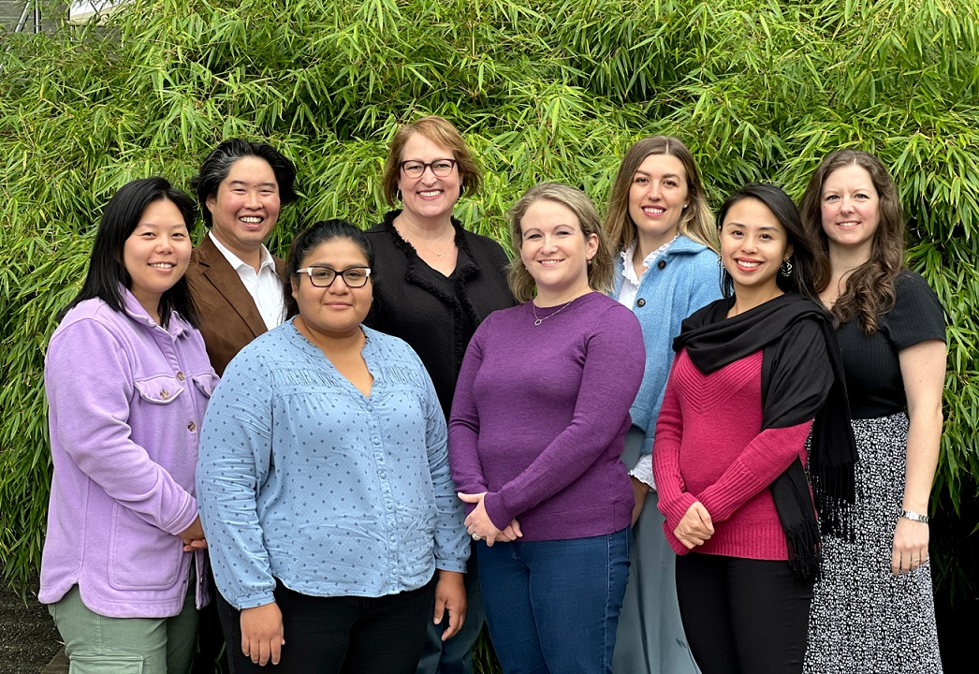
Questions?
University of Washington Bothell Counseling Center
www.uwb.edu/well-being/counseling
Monday-Friday 9 am-4:30 pm
UW1-080
425-352-3183
uwbcc@uw.edu
Notes:
Thank you so much for your time and attention, we hope this information was helpful
Now you’ve met one of the staff from the Counseling Center (again, I’m (your name)) so hopefully you’ll feel a little more comfortable sending your student our way if needed or reaching out if you have questions.
We are excited to be working with a new cohort of students in the fall!
[Time dependent] I am happy to take some questions here at the end before we wrap up this section. [Remember to restate the question into the microphone so all can hear the question before starting with the answer]

Slide 17

Notes:
This brings us to the end of our session on Relationships Matter- Navigating the College Transition.
We want to remind you that even as your college student increases their independence and autonomy you still play an important role and matter in their life as they make this adjustment. They need your support, approval and encouragement on this journey!

