Slide 1


PRE-HEALTH ADVISING
Notes:
Welcome to Pre-Health Advising! We'll provide an overview of this resource available to Huskies at UW Bothell.

Slide 2

Dedicated support for Huskies pursuing health career pathways through UW Bothell
PRE-HEALTH ADVISING
Dedicated support for Huskies pursuing health career pathways through UW Bothell
“Pre-Health” isn’t a major - it’s a pathway through many areas of study that support students in their pursuit of careers in healthcare.
Notes:
Pre-Health isn't a major - it's a pathway to various careers in healthcare supported through exploration and preparation with staff and peer advisors. We work with students considering careers in medicine, dentistry, pharmacy, and many other spaces in healthcare.

Slide 3

EXPLORE, PREPARE, APPLY - Explore
Explore
Self-Discovery and Exposure to various careers in healthcare
EXPLORE, PREPARE, APPLY
  Online Resources
    ExploreHealthCareers.org
    NW Health Career Path
  Alumni Connections
  Events
  Exploratory Courses
Supporting your students through each phase of their
Pre-Health Journey
Notes:
Using the Explore, Prepare, Apply framework, we support your students in making their pre-health journey their own.
We start with Exploration to support students in discovering their unique strengths and interests. Using tools such as Explore Health Careers and the NW Health Career Path, we learn about various careers in health and create a map to show alignment with roles.
We learn more about those roles through alumni connections and networking - finding people doing the work - where students can pursue career conversations and shadowing experiences.
We promote and host events aimed at supporting Pre-Health students, and we identify courses students might take based on their interests in health.

Slide 4

EXPLORE, PREPARE, APPLY – Prepare (Academics)
Prepare
Academics
Relationships
Experiences
EXPLORE, PREPARE, APPLY
  Exploratory Courses
  Prerequisite Courses
  Entrance Exams
Supporting your students through each phase of their
Pre-Health Journey
Notes:
Within the Prepare phase, there are three areas to focus on: academics, relationships, and experiences.
Academics is the area students tend to focus on - but this is just the first step! Professional health programs want to see - at a minimum - solid academic preparation in Biology, Chemistry, Physics, and Math. Those courses are foundational for what students study in medical, dental, pharmacy, and other professional health programs. The prerequisite courses prepare students for future coursework and also for entrance exams, which are sometimes required. We'll work alongside your student to unpack the prerequisites and exams they'll need for their chosen field.

Slide 5

EXPLORE, PREPARE, APPLY – Prepare (Relationships)
Prepare
Academics
Relationships
Experiences
EXPLORE, PREPARE, APPLY
  Professors
  Health Professionals
  Supervisors
  Mentors
  Peers
Supporting your students through each phase of their
Pre-Health Journey
Notes:
Within the Prepare phase, there are three areas to focus on: academics, relationships, and experiences.
Relationships are the key to learning as much as possible about a chosen field. We encourage students to have career conversations to connect with professionals and ask questions like "What do you find most fulfilling? What do you find most challenging? What advice do you have for someone considering this field?"
Relationships with professors are also crucial in pre-health students' preparation. Going to office hours, asking questions about research, and sharing goals can help a faculty member connect students with opportunities.
These relationships can result in strong letters of recommendation, and most professional health programs want to see at least three - an academic, a professional, and a character reference. We often suggest a science professor, a health professional, and a supervisor, mentor or 2nd from either of the prior categories. These individuals will be more willing to write letters if your student takes the time to get to know them and let themselves be known, too!
Peers can also be a great resource. Students sometimes compare themselves to their peers - but this is not a competition. They should focus on collaboration and how they can help each other access resources and information. After all, healthcare professionals collaborate constantly - working together can help pre-health students deepen this skill.

Slide 6

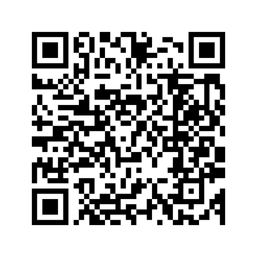
EXPLORE, PREPARE, APPLY – Prepare (Experiences)
Prepare
Academics
Relationships
Experiences
EXPLORE, PREPARE, APPLY
  Shadowing
  Research
  Volunteerism
  Paid work
  Connect the dots!
Supporting your students through each phase of their
Pre-Health Journey
Getting Experience >
Notes:
Students often seek experiences, and the key is starting with relationships! Career conversations with health professionals can lead to shadowing opportunities. Think about it - if a conversation goes well, asking to shadow seems like a natural next step. Asking to shadow before a conversation happens doesn't ensure that the shadow will be a good match.
Similarly, talking with professors and showing interest in their research can lead to an invitation to work on that research. Blind applications don't demonstrate alignment the same way a conversation can, so encourage your student to go to office hours and have these talks with their instructors. Even if that instructor isn't conducting research the student is interested in, the instructor might know another professor who is, and they can connect your student.
Volunteerism, paid work, leadership in student organizations, and all kinds of experiences help your student develop skills and demonstrate alignment with health. Visit our website on Getting Experience with your student and help them identify ways to get started this summer!

Slide 7

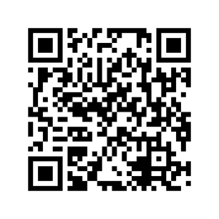
EXPLORE, PREPARE, APPLY – Prepare (Apply)
Apply
Application support, even after graduation
EXPLORE, PREPARE, APPLY
  Jobs
  Internships
  Scholarships
  Graduate & Professional Health Programs
Supporting your students through each phase of their
Pre-Health Journey
Application Support >
Notes:
Pre-Health Advising supports students through applications to experiences (jobs, internships, scholarships) and graduate and professional health programs while they're enrolled and up to 36 months after graduation. This means that those pursuing a gap between undergrad and graduate study can still receive support!
We help review their application materials, address questions about the process, and provide personal statement and interview success workshops.

Slide 8
APPLICATION SUCCESS
APPLICATION SUCCESS
MEDICINE | DENTISTRY | PHARMACY
Average GPA | Average GPA | Average GPA
3.63 | 3.55 | 3.40
Average test score (MCAT) | (DAT) | None
508 | 420
Sampling of Schools Admitted to | Sampling of Schools Admitted to | Sampling of Schools Admitted to
Albert Einstein SOM Arizona Cornell Drexel Kaiser Permanente SOM Loma Linda Mayo Clinic Rush Tufts Tulane University of Washington WSU Elson S. Floyd COM | Arizona Midwestern Pacific Northwest U Touro College of Dental Med University of New England USC University of Washington WESTU | Concordia University Keck Graduate Institute Oregon State University UC San Diego Univ of Health Sciences STL University of Nebraska University of Washington Washington State University
UWB Husky Admissions
UW Bothell Huskies successful in their applications to professional health programs applied with these metrics. Keep in mind that these are averages, and that the data is dependent on students self-reporting their admission. It’s not perfect, but it gives us an idea of where students should aim when applying to these programs.
Metrics (GPA and test scores) are only the threshold; committees are looking for demonstrated capacity to offer admission.
Notes:
This chart gives us an idea of where students might aim when applying to these programs. By looking at stats from those whose applications were accepted, we can help a student assess their readiness to apply in this area.
Grades and GPA are only a starting point, though. Applicants need to demonstrate - within their personal statements and activities logs - how they are motivated for this career, how they've shown they are able to do the work, and what goals they have within the profession.

Slide 9
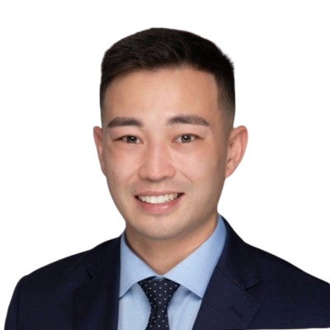


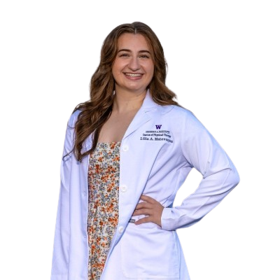


UW BOTHELL HUSKIES IN HEALTHCARE
BS 2018
BA 2020
BA 2022
Andrew Collins
UCF SOM 2023
UW Medical Center
Casey Cummins
UW SOM 2025
UCLA Medical Center
Vy Mai
UW SPH 2024
Project Access Northwest
Across disciplines, our graduates are making real impacts in healthcare - from medicine to pharmacy and healthcare administration, UW Bothell Huskies go on to graduate programs and health careers that
BA 2023
BS 2024
BS 2020, MBA 2025
Lilia Matevosyan
Physical Therapy Student
University of Washington
Bardia Ghazi
Entering Medical Student
University of Washington
Kiana Imani
UW SOP 2026
EvergreenHealth Pharmacy
Notes:
These are just a few examples of UW Bothell Huskies making real impacts in healthcare. These alumni have also given back to our community, mentoring pre-med, pre-pharmacy, and pre-health administration. These trailblazers are clearing the path for future Huskies in Health, ensuring that our impacts sustain throughout our communities and region.

Slide 10

NEXT STEPS
How can you support your Husky on their Pre-Health Journey?
01
02
03
Pre-Health Mailing List
Encourage Outreach
Encourage Experience
Encourage them to sign up for the UWB Pre-Health Mailing List to ensure they receive our messages!
Encourage them to reach out to their own health providers or others they know to ask questions about working in healthcare.
Look at the Getting Experience page together and identify ways they can gain exposure even now!
Notes:
01 - the Pre-Health Mailing List - Encourage them to sign up for the UWB Pre-Health Mailing List to ensure they receive our messages!
02 - Encourage Outreach - Encourage them to reach out to their own health providers or others they know to ask questions about working in healthcare.
03 - Encourage Experience - Look at the Getting Experience page together and identify ways they can gain exposure even now!

Slide 11
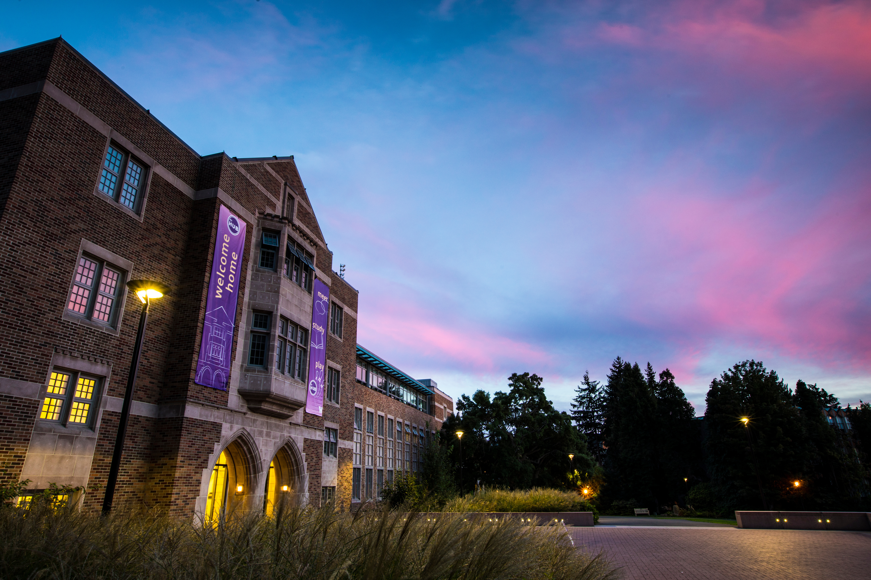
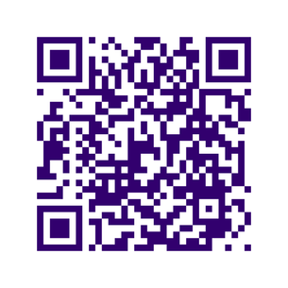
THANK YOU
THANK YOU
Ask your student to connect with us and join the Pre-Health Mailing List!
GET IN TOUCH
uwbprehealth@uw.edu
UW1-103
Notes:
Thank you for joining us today! Please remind your student to join the Pre-Health Mailing List - they can email us at uwbprehealth@uw.edu and visit us in UW1-103.

