Slide 1
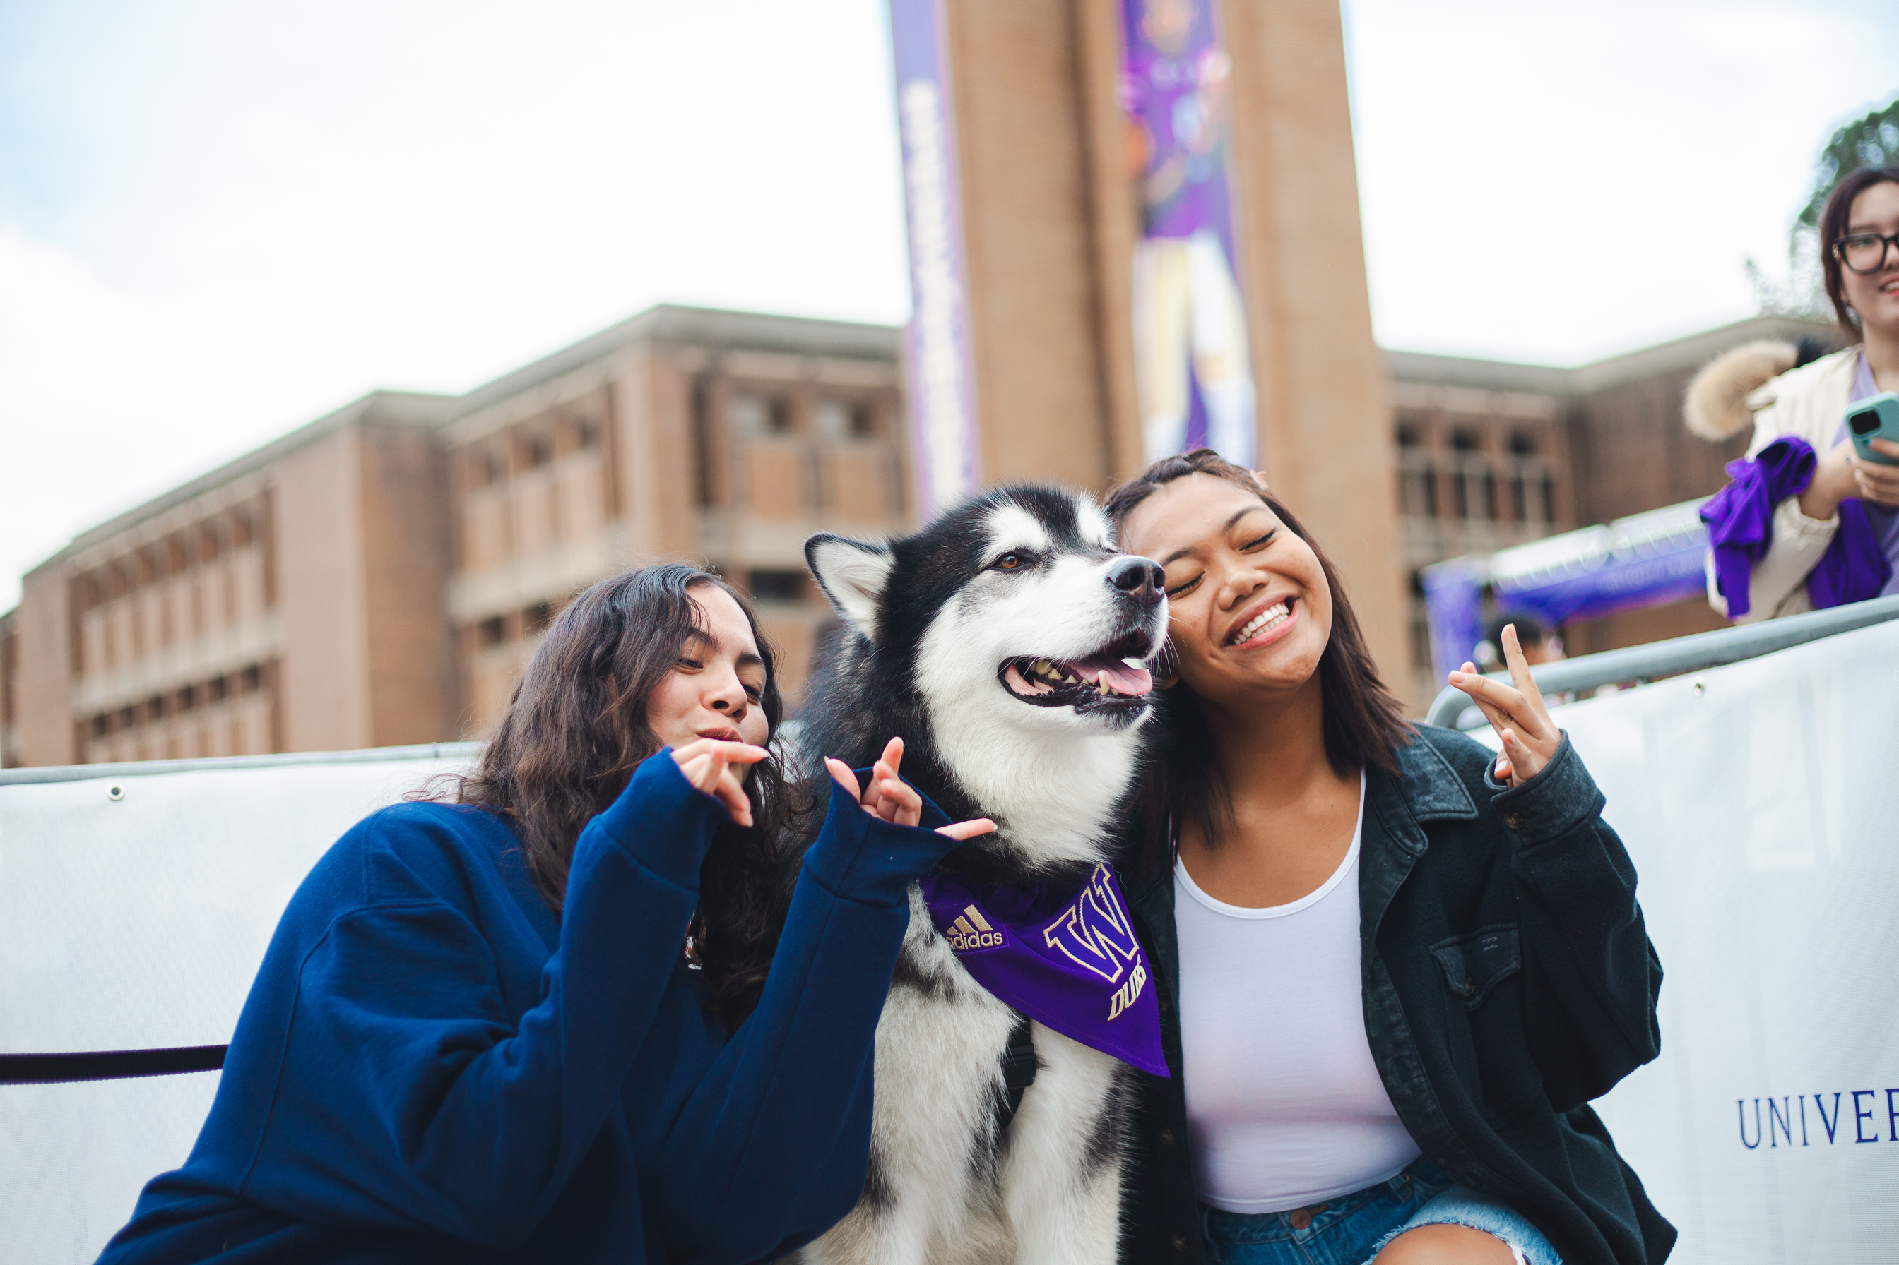
BEYOND THE CLASSROOM
Notes:
Welcome to Beyond the Classroom!

Slide 2
How internships, research,
community engagement, & study abroad support your student’s
career journey
Notes:
Believe it or not, your student is ready to start their career. In many ways, it's already begun! Today, we're going to share with you ways in which studying abroad, conducting undergraduate research, and completing internships can deepen skills they already have - and help them learn new ones! - so they're prepared for each next step on their career path.
We are sharing these with you so you can support them not only in pursuing these opportunities, but also in seeing how they connect to the world of work.

Slide 3

YOUR STUDENT ALREADY HAS SKILLS
  Self-Development
  Communication
  Critical Thinking
  Inclusion
  Leadership
  Professionalism
  Teamwork
  Technology
Notes:
Your student already has skills. Many of them are caregivers for siblings or grandparents. They might have already had part-time jobs or held leadership positions in clubs. They've done group projects in class. All of these activities build skills employers seek from job candidates. Whether they're applying to a part-time job during college, a full-time job after graduation, or scholarships and programs in between - we'll help them talk about their skills to gain access to more opportunities that will help them develop and prepare for each next step.
The skills employers seek from college graduates aren't just industry-specific. These skills are those they've already learned and can continue to develop during their time in college.

Slide 4

YOUR STUDENT ALREADY HAS SKILLS: Professionalism
  Self-Development
  Communication
  Critical Thinking
  Inclusion
  Leadership
  Professionalism
  Teamwork
  Technology
Notes:
Let's focus on professionalism for a second. That's a big word that simply means "showing up." Being present, engaged, taking initiative, participating, following-through - these are all ways employers and graduate programs have described "professionalism." Helping your student unpack this concept - and any myths about it having to do with appearance, dress, etc. will be a great way to support their learning both in the classroom and beyond it.

Slide 5
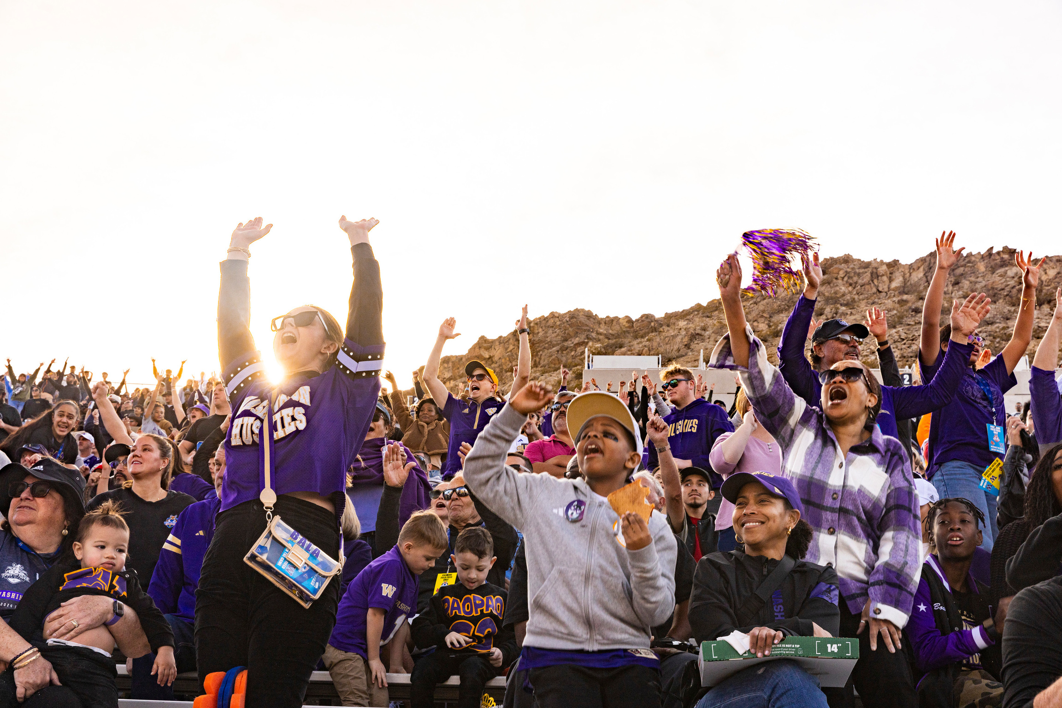
OPPORTUNITIES FOR HANDS-ON LEARNING
Study Abroad
Earn college credit in almost any country and any field to broaden your perspective and impact. Aid is available!
Research
Discover new knowledge or create original work, usually under the guidance of a faculty member.
Community-Engaged Learning
Collaborate in hands-on learning experiences through placements or projects with community partners.
Internships
A professional work experience in a real workplace - gain experience, apply skills and explore career pathways.
Notes:
Today we want to share a few examples of how students can learn beyond the classroom - what we refer to as hands-on or experiential learning. There are many ways beyond these - we're just going to highlight a few.
Through study abroad, students can earn college credit in almost any country and any field to broaden your perspective and impact. Financial aid is often available to make these trips accessible.
Through undergraduate research, students discover and create knowledge under the guidance of a faculty member, earning college credit and contributing to what we know and how we know it.
Students in community-engaged learning classes partner with community organizations to make real impacts in how they operate.
And internships are a professional work experience where students gain experience, apply their skills and learning, and explore career pathways in an industry.

Slide 6
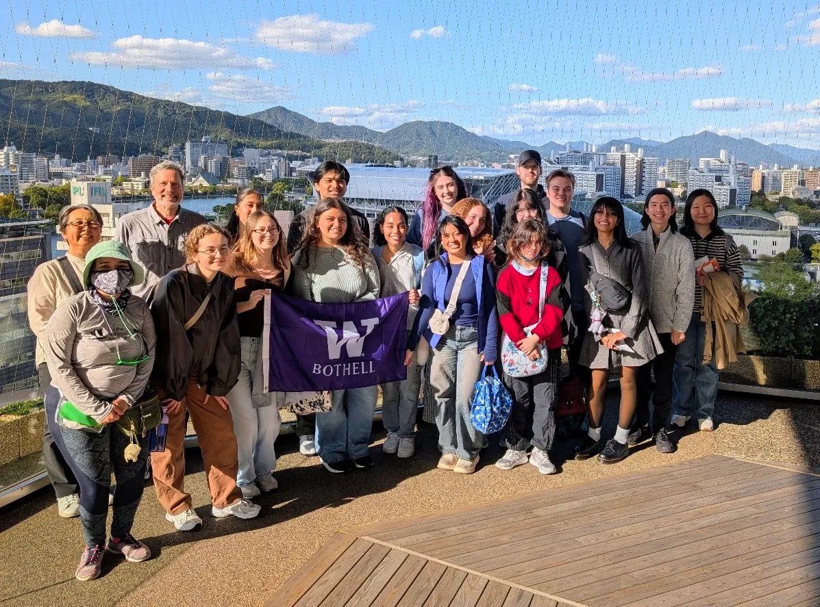
IMPACTS OF EXPERIENTIAL LEARNING study abroad
Study Abroad
Earn college credit in almost any country and any field to broaden your perspective and impact. Aid is available!
  Resilience
  Adaptability
  Problem-Solving
  Independence
  Cross-Cultural Communication
  Cultural Awareness
  Global Perspective
Notes:
By studying abroad, students learn what it's like to live in another culture, navigating unfamiliar systems to develop independence and confidence. They build relationships with diverse people, expanding their personal and professional networks along the way. The skills most valued by employers and graduate programs include resilience, adaptability, problem-solving, and communication.

Slide 7
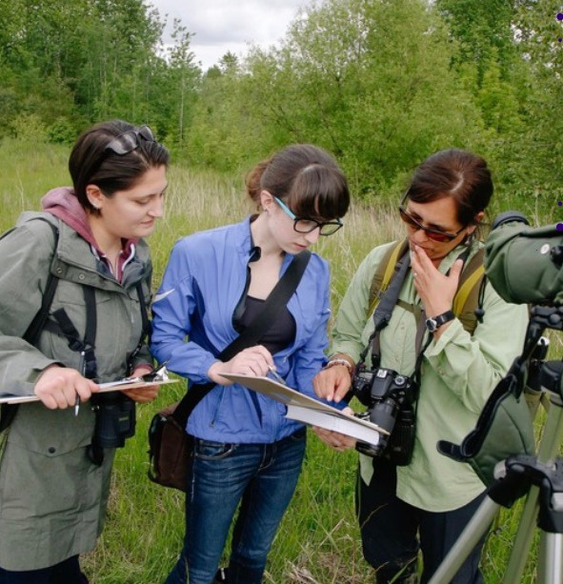
IMPACTS OF EXPERIENTIAL LEARNING research
Research
Discover new knowledge or create original work, usually under the guidance of a faculty member.
  Critical Thinking
  Analytical Reasoning
  Data Analysis & Interpretation
  Teamwork
  Written/Oral Communication
  Project Management
Notes:
Through conducting research, students make real-world impacts, such as studying environments to inform decisions about sustainability to learning how proteins interact to inform health treatments. The attention to detail and critical thinking required to collect and analyze data are valuable to many employers, and students often gain clarity on graduate programs and careers they might not have known existed!

Slide 8
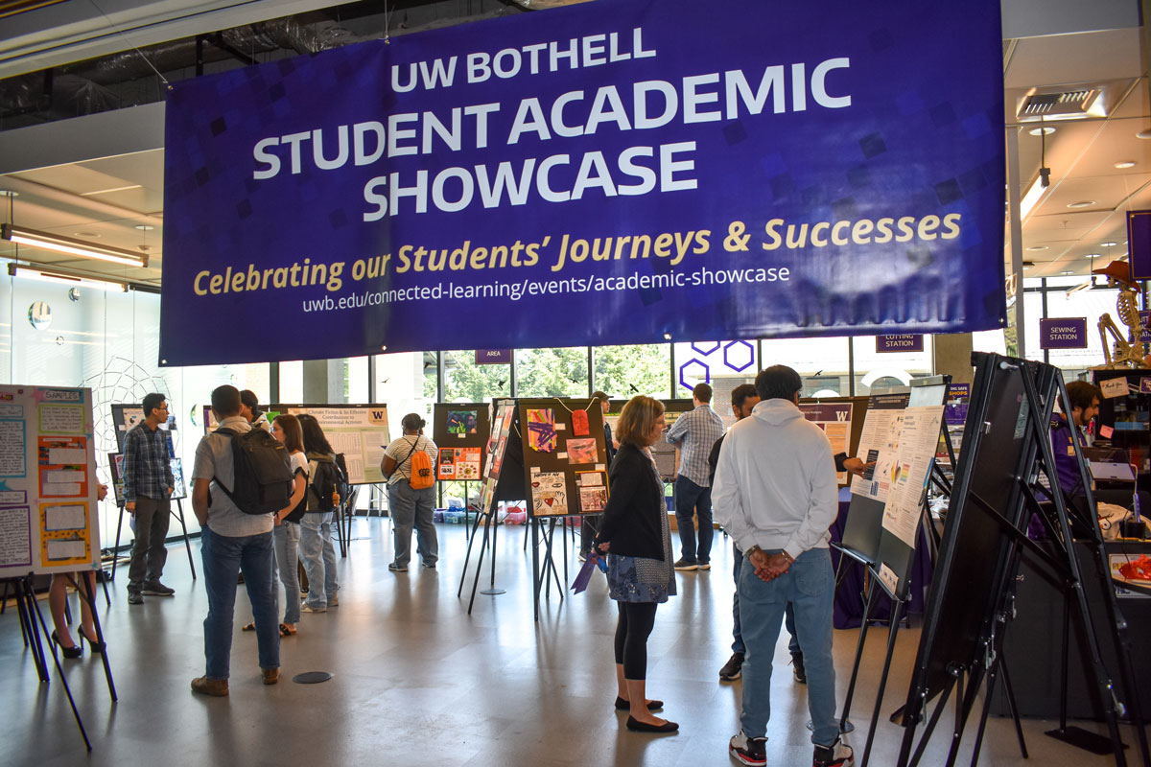
IMPACTS OF EXPERIENTIAL LEARNING community-engaged learning
Community-Engaged Learning
Collaborate in hands-on learning experiences through placements or projects with community partners.
  Leadership
  Teamwork & Collaboration
  Time Management
  Communication
  Relationship-Building
  Civic Responsibility
Notes:
By enrolling in CELR courses, students gain the opportunity to do meaningful work with community partners and gain a sense of purpose. This is work they can put on their resume to describe skills that help them land jobs! They develop skills in leadership, teamwork, time management - and they build relationships that strengthen their networks so new opportunities come to them often without needing to search! Students can talk with their advisors to identify and sign up for CELR courses.

Slide 9
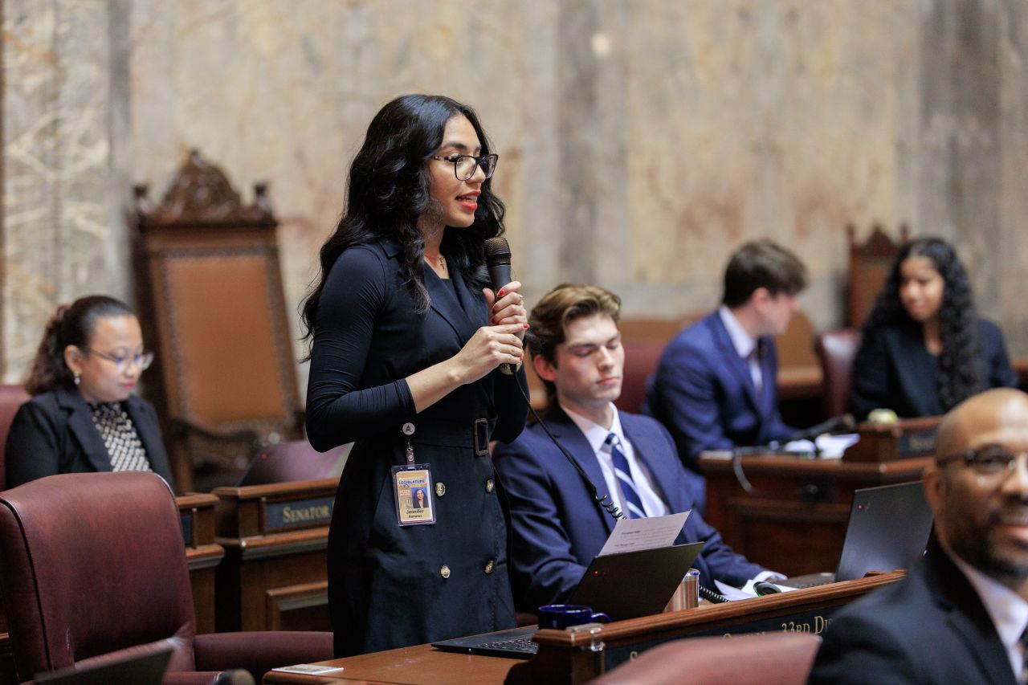
IMPACTS OF EXPERIENTIAL LEARNING internships
Internships
A professional work experience in a real workplace - gain experience, apply skills and explore career pathways.
  Professional Communication
  Teamwork
  Time Management
  Accountability
  Industry-Specific Skills
Notes:
Internships are a great way for students to gain professional experience. By working for a company or organization, they learn time management, accountability, and professional communication while often gaining industry-specific skills.
By completing a legislative internship with the Washington State Senate, Jennifer Ramirez met with constituents and lobbyists, tracked the progression of bills, and wrote bill briefings. She says, "Working as an intern pushed me outside my comfort zone and exposed me to a wide range of viewpoints through conversations with elected officials, constituents, advocates, lobbyists, and even fellow interns. In the meetings our office held, I learned about issues I had no prior knowledge of and had the opportunity to engage in meaningful conversations with those who were directly affected.
While initially nerve-wracking, my time at the legislature was also very fulfilling. I met hardworking and dedicated individuals who were willing to give us advice or offer a helping hand as we navigated the fast-paced and sometimes stressful work environment. This position helped my confidence in what I can offer, achieve, and learn through hands-on work."

Slide 10

EXPERIENTIAL LEARNING SESSION THIS AFTERNOON!
Study Abroad
Earn college credit in almost any country and any field to broaden your perspective and impact. Aid is available!
Research
Discover new knowledge or create original work, usually under the guidance of a faculty member.
Community-Engaged Learning
Collaborate in hands-on learning experiences through placements or projects with community partners.
Internships
A professional work experience in a real workplace - gain experience, apply skills and explore career pathways.
UW1-050 @ 1:30pm | 2:00pm | 2:30pm
Notes:
If you'd like to learn more specifics about these opportunities and HOW your student can take advantage of them, we are hosting an afternoon breakout session called "Experiential Learning" which will be in UW1-050 at 1:30pm, 2:00pm, or 2:30pm.

Slide 11
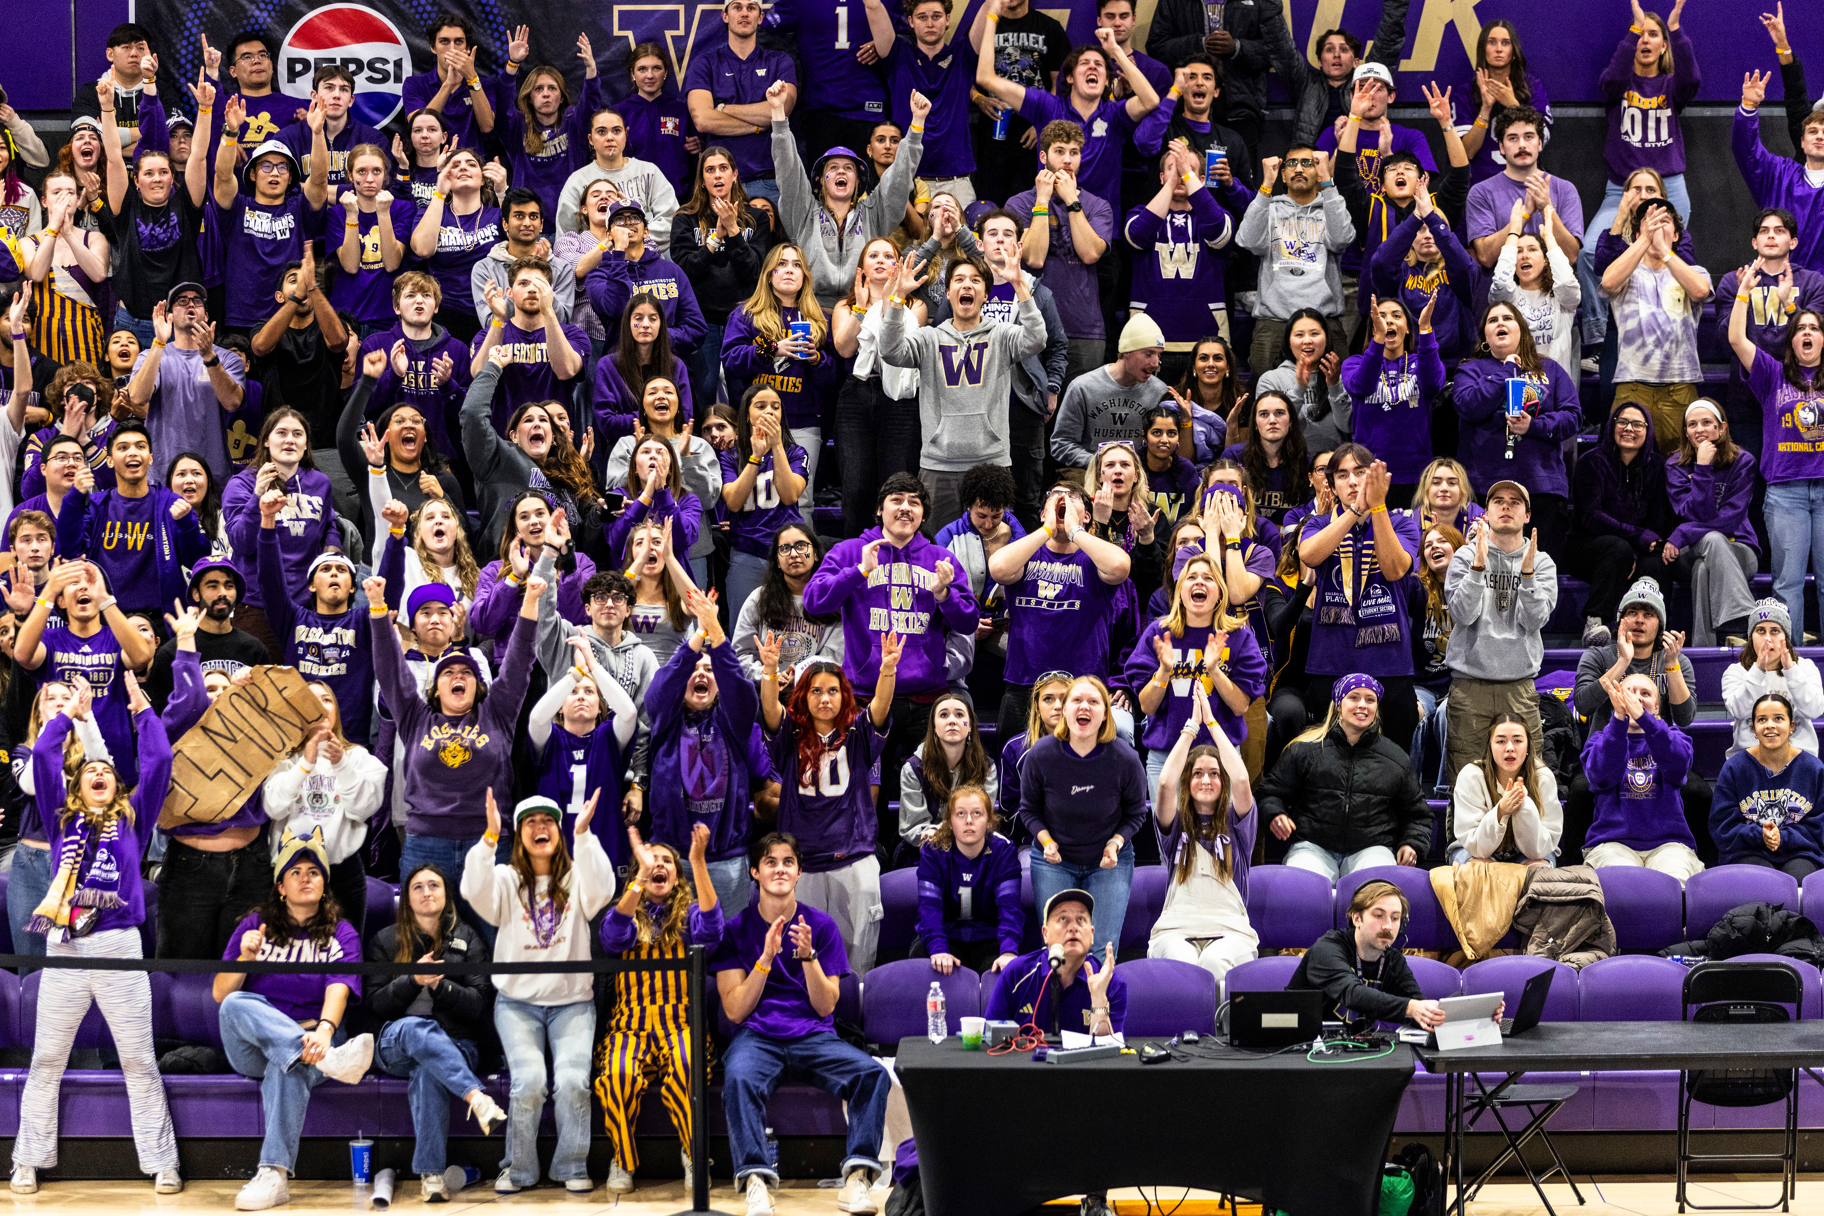
HOW LEARNING HAPPENS BEYOND THE CLASSROOM
  Apply classroom learning to real situations
  Gain career skills & professional connections
  Contribute to communities beyond campus
  Find belonging & a sense of community
  Draw on prior experience when applying to scholarships, awards, graduate school, jobs
Notes:
When your student applies classroom learning in real situations - often solving real problems for community partners - they'll gain skills and professional connections to give their own career a boost. Students have also reported that these activities help them feel a sense of belonging and community. Ultimately, our hope is that students can leverage their prior experience along with these activities when applying to scholarships, majors, graduate school, and jobs during or after college.

Slide 12
HOW EMPLOYERS DESCRIBE
UWB HUSKIES
Thoughtful communicators
Leaders &
team players
Innovative & creative thinkers
Highly professional
Diverse, engaged citizens
This is a result of campus-wide investment in students’ career development - it happens both in the classroom and beyond!
Notes:
When we survey employers, they point out these top qualities of our students.
At Bothell our students are exceptionally employable because of their readiness in leadership, teamwork, communication, and creative thinking on the job.
These are comments on those who have been hired, done internships, completed community-engaged learning courses, etc. Employers value the communication, professionalism, leadership and innovation, diverse and purpose-driven traits that characterize our students.
And our students develop these traits not only in class but also through experiential learning - it is campus commitment to help students get a degree and good job after graduation.

Slide 13
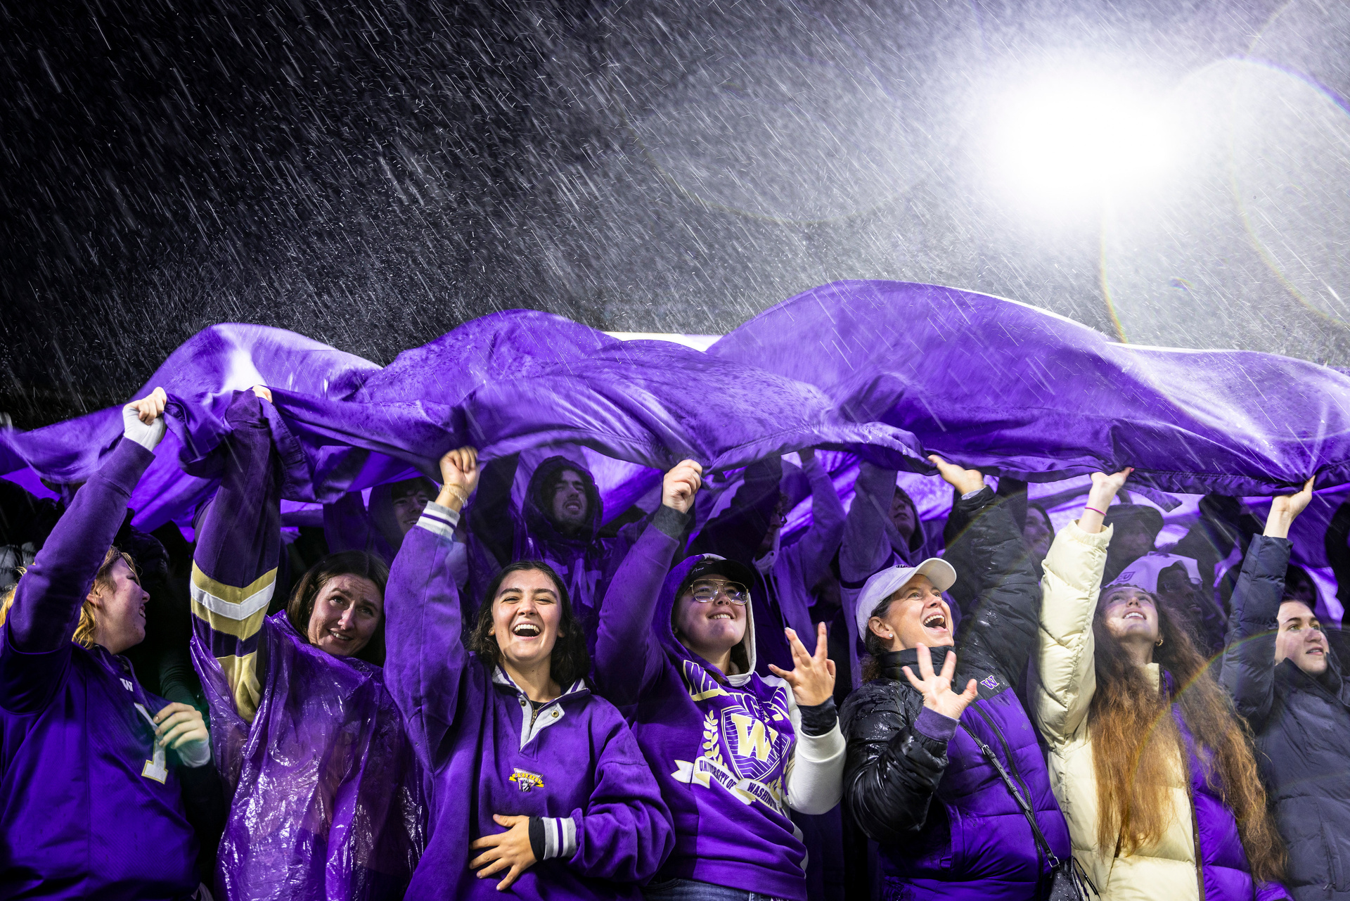
RETURN ON INVESTMENT
01 | Highest Wages Educational Resource & Data Center, March 2025
$ | $77,000 annually Lightcast, 2025
02 | #2 Overall Niche.com, 2026 & SmartAsset, 2025
01 | #1 Regional US News & World Report, 2026
Notes:
Your investment in your student's college education will have real payoffs.
The wages of UW Bothell alumni with bachelor’s and master’s degrees are consistently the highest in the state among all graduates with comparable degrees from public, four-year institutions.
On average, undergraduate alumni earn an average of $77,000 annually, according to 2026 Lightcast data.
UW Bothell is ranked #2 overall in Washington among public universities for value and return on investment.
And we're ranked the #1 regional university in Washington state.

Slide 14
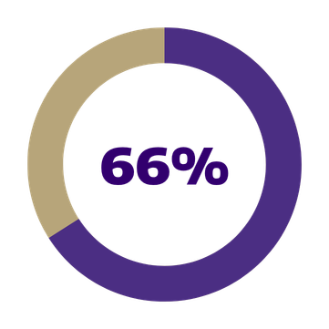
EMPLOYMENT OUTCOMES
  Software Developers
  Registered Nurses
  General & Operations Managers
  Accountants & Auditors
  Project Management Specialists
Top occupations one year after graduation
Management Occupations
16% | Within one year
19% | Within 3 years
24% | Within 5 years
34% | Within 10 years
Employed in Field
Within a year of graduation
The number increases to 69% within 5 years of graduation.
Notes:
Within one year of graduation, 2/3 of our alumni are employed in their field with the top 5 occupations being Software Developers, Registered Nurses, General & Operations Managers, Accountants & Auditors, and Project Management Specialists.
Alumni take on leadership - around 16% within the first year, and that number grows to around 34% within 10 years.
All those leadership skills your students bring and develop while at UWB support their readiness for leadership in the workplace!

Slide 15


CAREER & EXPERIENTIAL LEARNING CENTER
UW1 (Founders Hall),
Room 103
@uwb_career
@uwbstudyabroad
uwb.edu/career-services
uwb.edu/connected-learning
career@uw.edu
uwbocl@uw.edu
Notes:
Encourage your student to reach out to us, even starting this summer, if they have questions about experiential learning and career readiness.

Slide 16
QUESTIONS?
Notes:
Thank you for letting us share a bit with you about hands-on learning and how it can impact your students career readiness along with your return on investment!
We're happy to address any questions you might have.

