Slide 1

MONEY MATTERS: FINANCIAL AID
Notes:
Welcome
-Info session for the School of Business
-Overview of the business program, admissions requirements
-What materials do you have? Business Info Sheet, Planning Worksheet
-Introductions: Name, Transferring? Which program? What questions do you have?

Slide 2

OFFICE OF FINANCIAL AID
  Handles aid applications and offers
  Determines & monitors eligibility
  Manages awards
  Help in cases of special circumstances
  Scholarships
  Located in Summit Hall
  Phone: 425-352-5240
  E-mail: uwbfaid@uw.edu

Slide 3

Scholarships
Grants
TYPES OF FINANCIAL AID
Work-study
Loans
Scholarships are typically awarded using a variety of factors, including - but not limited to, academic achievement, departmental and community involvement, employment experience, areas of study, and financial need
Federal, state, and institutional funds offered on the basis of need, which you DON’T Have to pay back.
Money borrowed from the federal government to help pay for you education, which MUST be paid back
Jobs on campus allowing you to earn money to help pay for educational expenses
Notes:
Margarita 5-8

Slide 4
Grants
Federal, state, and institutional funds offered based on financial need, which you DO NOT pay back
Types of Aid

Slide 5
Grants
Scholarships
Federal, state, and institutional funds offered based on financial need, which you DO NOT pay back
Usually awarded using several factors, including, but not limited to: academic achievement, departmental and community involvement, employment experience, areas of study, and financial need
Types of Aid

Slide 6
Grants
Scholarships
Loans
Federal, state, and institutional funds offered based on financial need, which you DO NOT pay back
Usually awarded using several factors, including, but not limited to: academic achievement, departmental and community involvement, employment experience, areas of study, and financial need
Money borrowed from the federal government to help pay for your education, which MUST be paid back
Types of Aid

Slide 7
Grants
Scholarships
Loans
Work-study
Federal, state, and institutional funds offered based on financial need, which you DO NOT pay back
Usually awarded using several factors, including, but not limited to: academic achievement, departmental and community involvement, employment experience, areas of study, and financial need
Money borrowed from the federal government to help pay for your education, which MUST be paid back
Jobs on campus allowing you to earn money to help pay for educational expenses
Types of Aid

Slide 8
SUBSIDIZED VS UNSUBSIDIZED
Subsidized Loan
Need based
Interest paid by government while student attending school ½ time or more
Unsubsidized Loan
Non-need based
Government does not pay interest
Students have option of paying interest while attending school or have it added to the principal

Slide 9
STUDENT LOAN DISBURSEMENT
Federal Student Loans are part of financial aid.
FAFSA must be completed to be able to borrow money.
Once a Financial Aid offer is made: you can accept your loans, complete Loan Entrance counseling, and sign the Master Promissory Note
Parents complete PLUS loan request online at studentaid.gov and sign the Master Promissory Note (MPN)
Interest rates are posted on Financial Aid web page under loan chart: https://www.washington.edu/financialaid/types-of-aid/loans/student-loans-program-chart/
Rates can change every year

Slide 10
AWARD PROCESS AT UW
STUDENTS CONSIDERED FOR GRANTS, LOANS, & WORK-STUDY
ACCEPT FINANCIAL AID AWARD
IF BORROWING STUDENT LOANS
UW RECEIVES YOUR FAFSA INFO
ON
MyUW
ACCOUNT
3-5 WEEKS AFTER FILED
STUDENT SIGNS PROMISSORY NOTE (MPN)

Slide 11
All aid is divided equally between all quarters of attendance
Aid automatically pays for tuition each quarter. Extra unused funds go to the student
Set up direct deposit to receive funds faster
BUDGET ITEMS
& FINANCIAL AID DISBURSEMENTS

Slide 12
Payment
Aid disbursement starts a few days before the quarter
Tuition is due by the 3rd Friday of each quarter
UW Housing—due by the 3rd Friday of each quarter
Aid pays tuition and fees and housing charges on your student’s account
Any unpaid UW Housing charges are directly billed by UW Housing after the third week of the quarter
Remaining aid will be sent direct deposit or mailed to the student

Slide 13
2026-2027 NINE-MONTH STUDENT BUDGET
 | Resident | Non-Resident
Undergraduate Tuition | $13,476 | $45,131
Direct Cost
Charged by school and needs to be paid quarterly
 | LIVES WITH PARENTS |  | TRADITIONAL | NON-TRADITIONAL
 | Undergrad | Grad | Undergrad | Undergrad | Grad
New Student Enroll/ Orientation* | $ 425* |  | $ 425* | $ 425*
Books | $ 900 | $ 900 | $ 900 | $ 900 | $ 900
Food | $4,338 | $ 4,338 | $ 6,534 | $ 6,534 | $ 6,534
Housing | $1,818 | $1,818 | $12,021 | $15,837 | $15,837
Personal | $2,508 | $2,508 | $2,508 | $2,508 | $2,508
Transportation | 1,074 | 1,074 | 1,074 | 1,074 | 1,074
TOTAL | $ 11,063 | $ 10,638 | $ 23,462 | $ 27,278 | $ 26,853
Indirect cost
Listed to help student budget for expenses they may have while attending.
This is not a bill
Needs to be paid to school only when student lives on campus

Slide 14
FINANCIAL AID FORMULA
Cost Of Attendance (COA)
Student Aid Index (SAI)
FINANCIAL NEED
-
=
Tuition
Housing
Food
Books
Living Expenses
Transportation
Parent income
Parent assets
Student Income
Student assets
# in household
The maximum amount of aid a student may receive in a single academic year

Slide 15
EXAMPLE OF PAYMENTS WITH ON-CAMPUS HOUSING
QUARTERLY CHARGES
QUARTERLY AID
$4,600
  Resident tuition (full-time)
$3,597
  Summit Hall double suite
$2,777
  Weekly 14 meal plan
$8,680
  Grant aid
$1,742
  Loans
TOTAL:
$10,974
TOTAL:
$10,422
Quarterly amount not covered by Financial Aid:
$522

Slide 16
EXAMPLE OF PAYMENTS WITH ON-CAMPUS HOUSING
1: TUITION PAYMENT
$10,422 – $4,600
2: HOUSING AND MEAL PLAN PAYMENT
QUARTERLY HOUSING & MEAL PLAN – AID REMAINING:
$6,374 – $5,822
3: REMAINING BALANCE
= $5,822 AID REMAINING
$522 NOT COVERED BY FINANCIAL AID, STUDENT RESPONSIBLE FOR PAYING
QUARTERLY AID – QUARTERLY TUITION:
= $522 REMAINING BALANCE
MAY BE PAID BY SCHOLARSHIP, FAMILY CONTRIBUTION, ADDITIONAL LOAN, ETC.

Slide 17
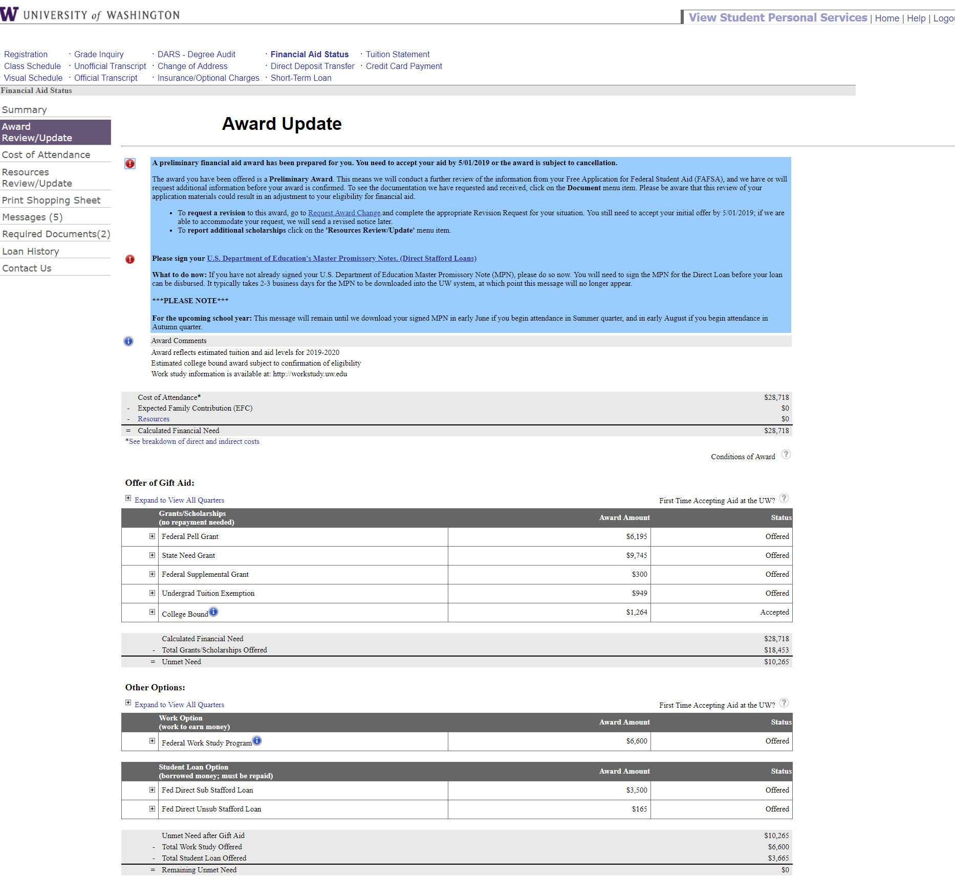
NAVIGATING MYUW ACCOUNT

Slide 18
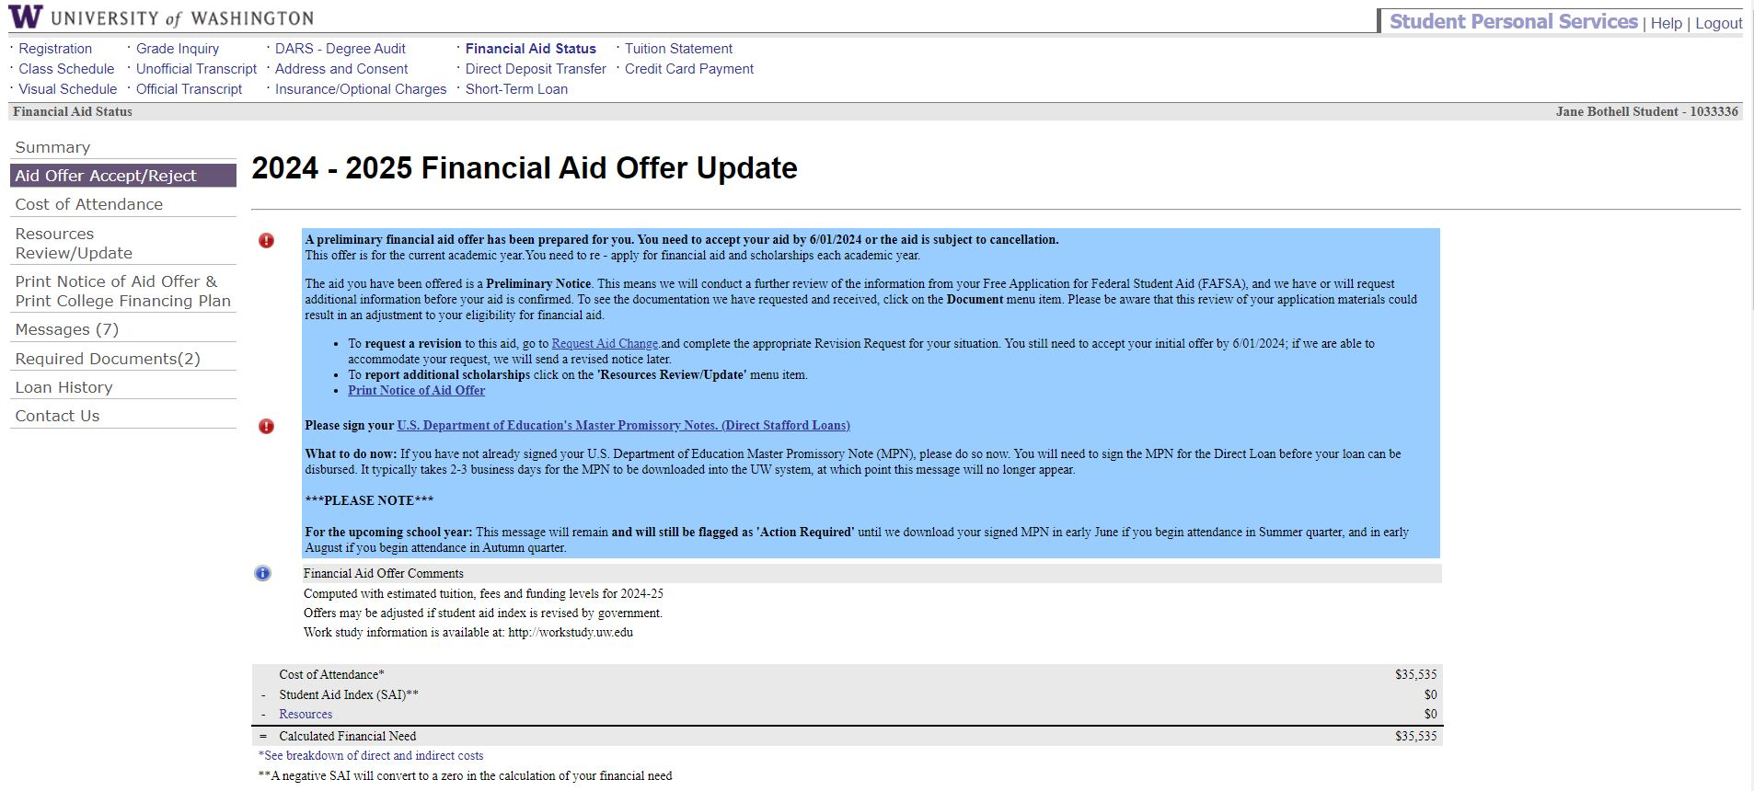
FINANCIAL AID MESSAGES

Slide 19
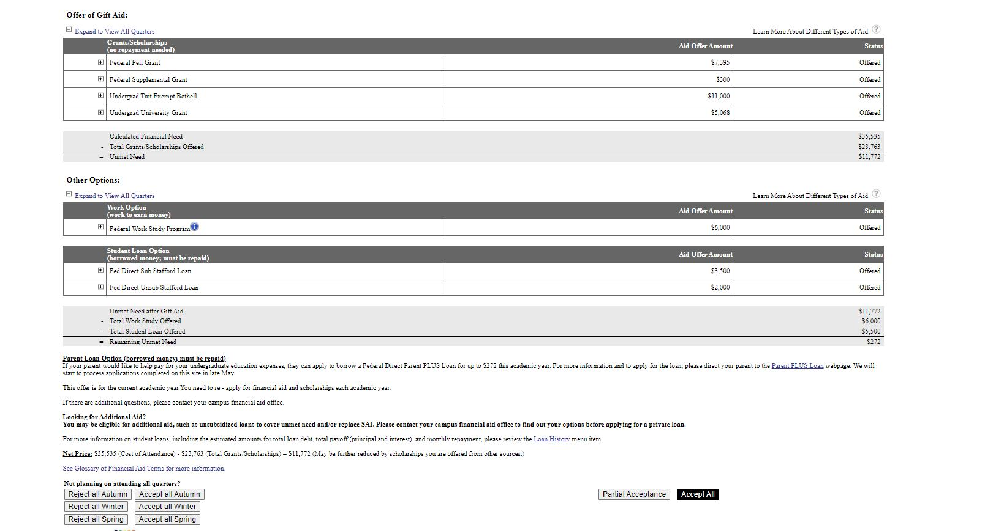
GRANTS, WORK STUDY, & LOANS

Slide 20

SPECIAL CIRCUMSTANCES AND VERIFICATION REQUESTS
The following information is not filed on FAFSA or WASFA and should be discussed with financial aid. Special circumstances will be reviewed and may require additional documentation.
  Change in employment status after filing FAFSA.
  Medical expenses not covered by insurance.
  Change in parents’ marital status after filing FAFSA.
  Unusual dependent care expenses.
The financial aid office may reach out to students and request additional verification documentation such as:
  Citizenship documentation
  Tax returns
  Other information as requested

Slide 21
SCHOLARSHIPS
UW BOTHELL SCHOLARSHIP:
Managed by Financial Aid office
EXTERNAL SCHOLARSHIPS:
Parent’s place of work, Local civic organizations/ businesses in which student may participate, local library resources, free online searches
You should never pay money to get money. If so, it’s probably a scam
Application available annually in Spring quarter for continuing students
ONLINE SCHOLARSHIP RESOURCES:
UW Office of Merit Scholarships, Fellowships & Awards
    https://scholarships.uw.edu/
FASTWEB
    www.fastweb.com
UW Scholarship Database
  https://new.expo.uw.edu/expo/scholarships/
theWashBoard.org
    https://washboard.wsac.wa.gov/login.aspx

Slide 22
529 Plans
Educational savings plans, like 529 plans or Washington GET are sent to Student Fiscal Services
Check with your plan’s administrator to set up the amounts you want to use and that your student attends the UW
Funds will flow through the student account to pay UW charges
Student Fiscal Services Contact Info:
  sfshelp@uw.edu
  206-543-4694

Slide 23
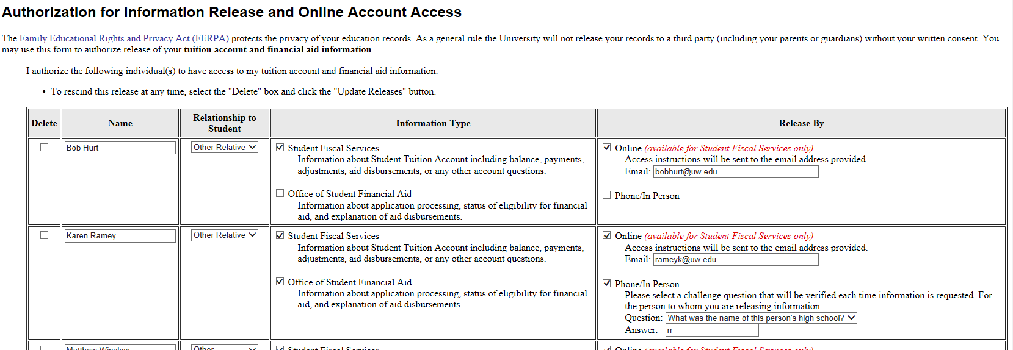
INFORMATION RELEASE FORM
Provides a 3rd party access to your financial aid information
Required by FERPA for us to speak with anyone about your account
Link to form is in your MyUW account under tuition statement

Slide 24
INFORMATION RELEASE FORM
Provides a 3rd party access to your financial aid information
Required by FERPA for us to speak with anyone about your account
Link to form is in your MyUW account under tuition statement

Slide 25

FINANCIAL AID OFFICE
425-352-5240
uwbfaid@uw.edu
WWW.UWB.EDU/STUDENTS/FINAID

