Slide 1

Signature
FIRST YEAR
EXPERIENCE at UW Bothell
Notes:
Advisor covers slides 1-3
Faculty covers slides 4-7
Advisor covers slides 8-14

Slide 2

First Year Students Might Be Hearing…
Define career goals!
Make friends now!
Be Creative!
Think differently! Take chances! No limits!
Get done with college as fast as possible!
Try new things!
Get a job!
Join as many clubs as possible!
Find a mentor!
Be positive about everything!
Build professional networks!

Slide 3
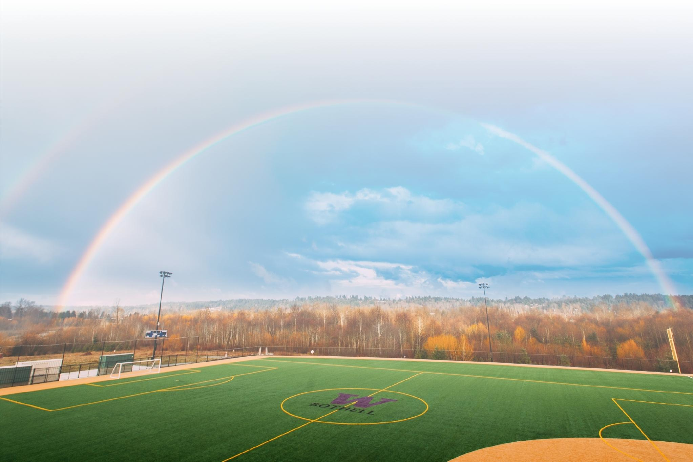
FIRST YEAR STUDENT LIFECYCLE
ADMITTED
WELCOME WEEK & CONVOCATION
1
2
3
4
ADVISING & ORIENTATION
DISCOVERY CORE
ONGOING PEER COACH & ADVISING SUPPORT
Notes:
Peer coaches are unique to UWB (no other UW system has something like this at this scale). Peer coaches are undergraduate students who are both welcoming and trained to help students navigate college (we know it can be confusing)!
Every incoming first-year student chooses a peer coach they feel they can connect with.
That coach meets them at orientation over the summer then meets with them throughout the academic year (fall – spring)
Main Role: individual coaching sessions where students share what they're looking for out of college, what their goals are, or even how they're struggling. The coach works with them to get the most out of their time at UWB and normalize what it looks like to face/overcome challenges in college.
Support: Coaches work with staff across campus to ensure students are supported in every area. This could look like coaches personally referring students to tutoring or Career Services. It could also look like coaches reminding students of important deadlines like tuition or registration.

Slide 4

UWB Academic Experience
UWB is on a Quarter System
  Autumn, Winter and Spring quarters are typical
  Each quarter is about 10-11 weeks
  Summer quarter is available, many students take Summer off
How many courses should a student take?
  3 courses per academic quarter is recommended
  Courses are commonly 5 credits each
What courses should a student take?
  Course guidance is provided at orientation
  There is purposeful room for students to explore

Slide 5
Components of a Bachelor's Degree at UWB
  180 credits total​
      15 credits/quarter at 3 quarters/year = 4 years​
        Timeline can vary based on many factors
  Degree requirements will vary based on major​
      All students will require General Education courses and electives ​
        UWB graduates have rich experience across multiple fields and disciplines!
Areas of Inquiry
(General Education Requirements)
Major Coursework
Electives

Slide 6
FIRST YEAR COMMUNITY
New Students
  Meeting classmates
  Finding community
Faculty and Campus Resources
  Available year round
Academics
  Discover personal interests

Slide 7

DISCOVERY CORE EXPERIENCE (DCX)
Signature First Year Experience
First Year Student Focus
Dedicated Faculty
Small Class Size
Meets General Education Requirement
Notes:
Unique to UWB
Special topics –Arts & Politics of Walking, Dead thing and Art of Fear
Small class size (30 or less)
Faculty have to apply to teach
Cross disciplinary
Meets a general education requirement
Learn academic skills
https://www.uwb.edu/premajor/first-year/discovery-core/autumn-dcx

Slide 8
DISCOVERY CORE EXPERIENCE (DCX)
Boundless Learning
Tackles Cross Disciplinary Problems
Connection & Collaboration
College Success Skills
Purpose & Reflection
Notes:
Unique to UWB
Special topics –Arts & Politics of Walking, Dead thing and Art of Fear
Small class size (30 or less)
Faculty have to apply to teach
Cross disciplinary
Meets a general education requirement
Learn academic skills
https://www.uwb.edu/premajor/first-year/discovery-core/autumn-dcx

Slide 9

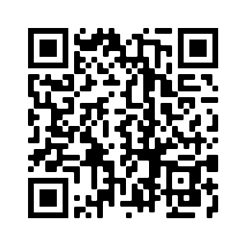
Learn more about Discovery Core
https://www.uwb.edu/premajor

Slide 10
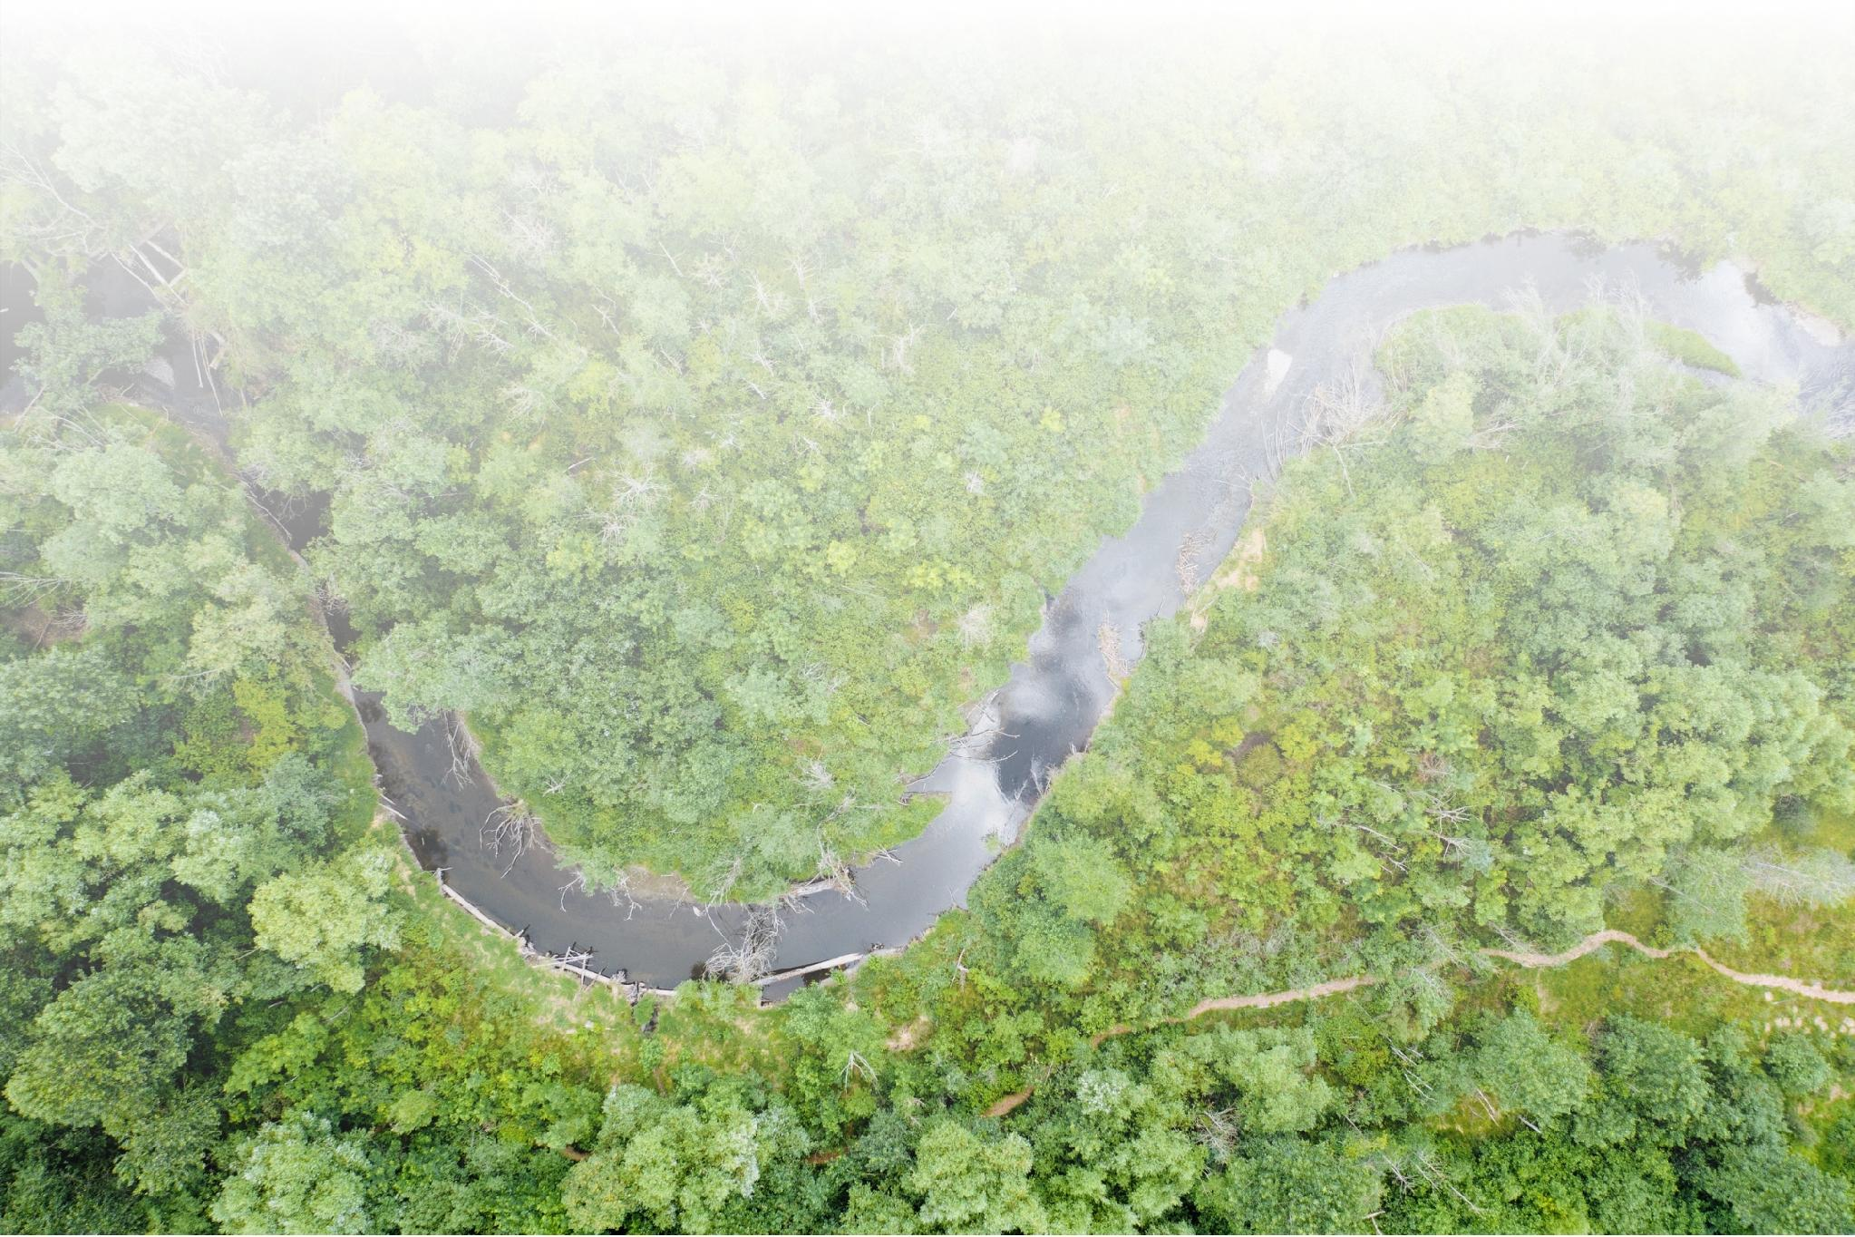
Path to Major Declaration/Application
Pre-Major
Declare or Apply for Major
Major Coursework
Freshman & Sophomore Year
Freshman or Late Sophomore Year
Sophomore, Junior, & Senior Year
Notes:
Not always linear, can take time!

Slide 11
The Meta-Majors
Groups of Majors
  Common Classes
  Areas of learning
  Career Goals
Based on Intended Major
Connects students to resources
  Research Opportunities
  Co-curricular
  Academic focus
Notes:
Starting college is an exciting yet overwhelming experience for both students and families.
Our goal at UW Bothell is to make this transition as smooth and manageable as possible.
The orientation process is designed to give students time to absorb information, reflect, and ask questions.
Step 1 – Online Learning
This step has two parts:
UWB 101
Foundational course on campus resources and processes.
Husky Prevention and Response
Required course on prevention and response to sex- and gender-based violence and harassment.
Both courses are asynchronous, allowing students to complete them at their own pace.
Once students finish both courses, they can move on to Step 2.
Step 2 – Live Advising & Orientation Session
This step builds on information from UWB 101 and focuses on connection.
For first-year students:
Two-day session:
Day 1: In-person
Day 2: Online
Students meet with their peer coach on Day 1.
Step 3 – Course Registration
Students select and register for courses for their first quarter.
This step finalizes their academic schedule and prepares them for the start of college

Slide 12

Majors at UW Bothell
Arts & Media
-Culture, Literature, and the Arts
-Interdisciplinary Arts
-Media and Communications
Business & Policy
-Business Administration
-Economics
-Environmental Studies
-Global Studies
-Law, Economics, and Public Policy
Education & Society
-American & Ethnic Studies
-Developmental & Youth Studies
-Educational Studies
-Elementary Education Option
-Gender, Women, Sexuality Studies
-Interdisciplinary Social Sciences
-Psychology
Health & Natural Sciences
-Biology
-Chemistry (Biochemistry Option)
-Conservation and Restoration Science
-Earth System Science
-Health Studies
-Nursing* (RN to BSN, Transfer Only)
Technology & Engineering
-Applied Computing -Computer Engineering -Computer Science & Software Engineering (Information Assurance & Cybersecurity Option) | -Data Visualization (BA or BS) -Electrical Engineering -Mathematics -Mechanical Engineering -Physics (BA or BS) -Science, Technology & Society

Slide 13

ACADEMIC ADVISING
The Advising Team Students will be assigned an advisor based on their intended major
Long-Term Planning
Map out degree requirements
Comprehensive Support Connect students to campus resources
Notes:
YOUR ADVISING TEAM: From your first year all the way to graduation, your advisor will guide you through every academic milestone, including pre-major exploration, major application, and beyond.
LONG-TERM PLANNING: Advisors with support with degree planning, course selection, and major selection and planning, ensuring a clear pathway to your academic goals.
COMPREHENSIVE SUPPORT: We serve as your central hub for academic needs, connecting you with invaluable campus resources like Career Services, The Writing Center, and the Counseling Center, fostering your overall success.

Slide 14

How much work is College?
Most learning in college happens outside the classroom
3 classes will typically be about 15 credits
Every credit enrolled: 2-3 hours of study each week
Average credits per quarter 15: 30-45 hours of study

Slide 15
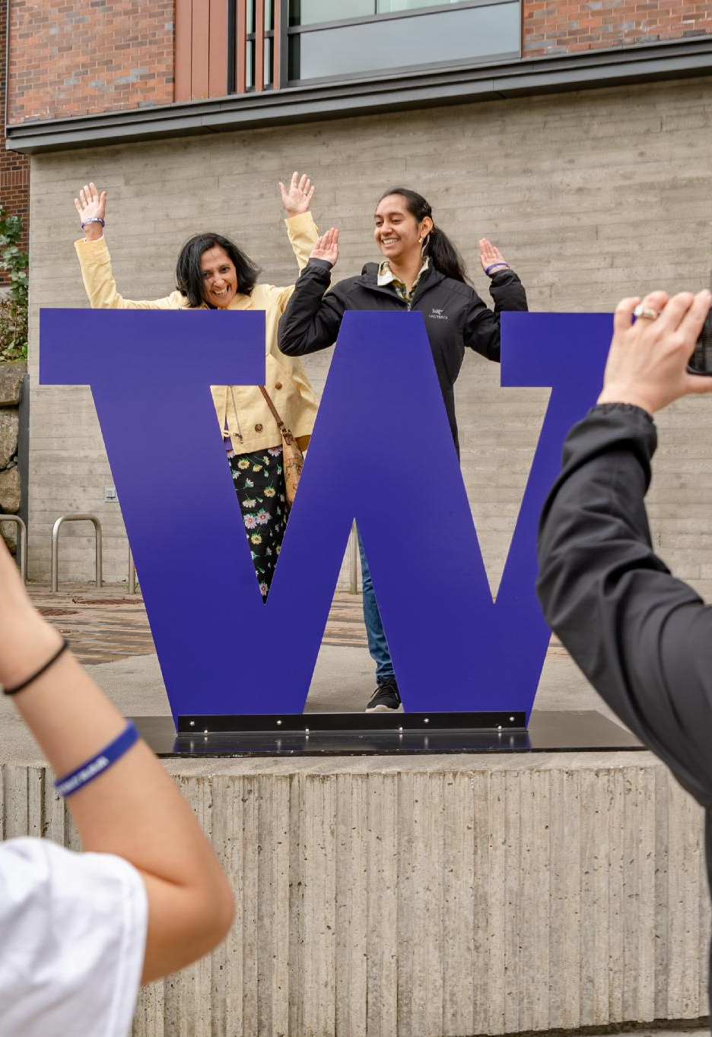
How can families help?
Your authentic support means the most!
Remind: Attend faculty office hours
Encourage: Campus club and community events
Support: Remind them to meet with their advisor
College is different than high school! 3 classes is a full-time job

Slide 16

THANK YOU &
HAPPY ORIENTATION!

