Slide 1
STUDENT FISCAL SERVICES

Slide 2
AGENDA
Tuition Statement
Information Release
Set up Direct Deposit
Pay by Webcheck - Online Bank Payment (Preferred method to pay!)
International Payments
Important information (Scholarships, WA529, etc.)
Questions?

Slide 3
TUITION STATEMENT
DUE BY THE 3RD FRIDAY OF THE QUARTER
Online Tuition Statement
  Found on MyUW
  Payment Options: https://finance.uw.edu/sfs/tuition-fees/pay-tuition-fees
Housing is managed separately!
  https://www.uwb.edu/campus-living/ (UW Bothell)

Slide 4
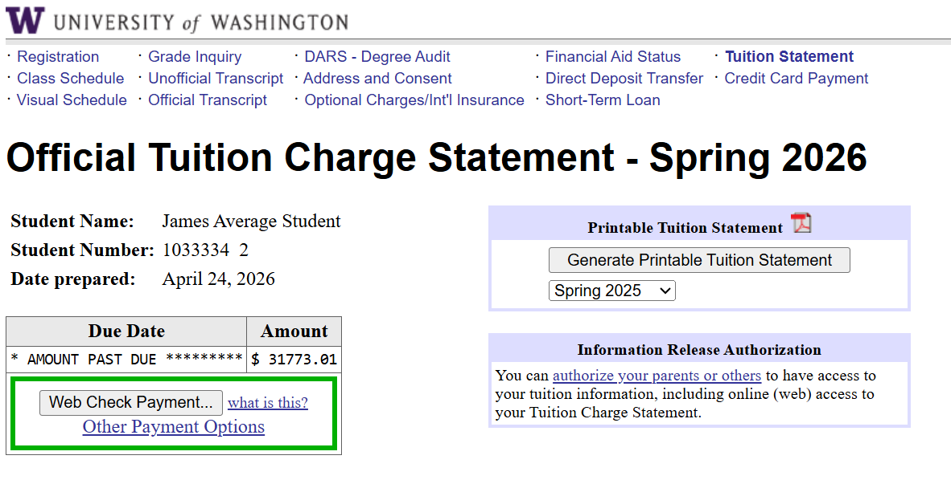
TUITION STATEMENT – contd.
Information Release
Set up Direct Deposit
Pay by Webcheck–
Online Bank Payment
Change Address

Slide 5
INFORMATION RELEASE – Pt. 1
Students gives YOU access

Slide 6
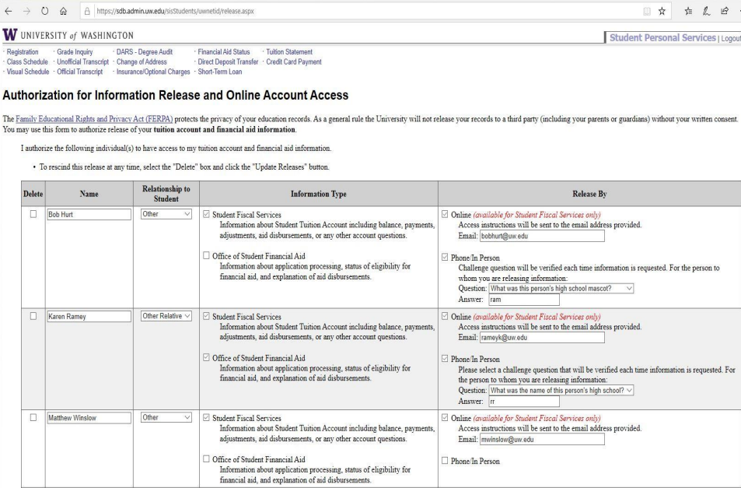
INFORMATION RELEASE – Pt. 2

Slide 7
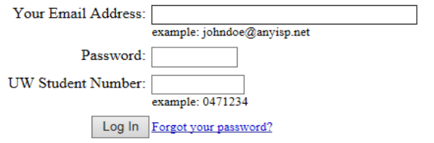
INFORMATION RELEASE – Pt. 3
You will receive an email with instructions once your student authorizes you
You will need the following information:
  Your student’s UW number
  You will see the image below to log in

Slide 8
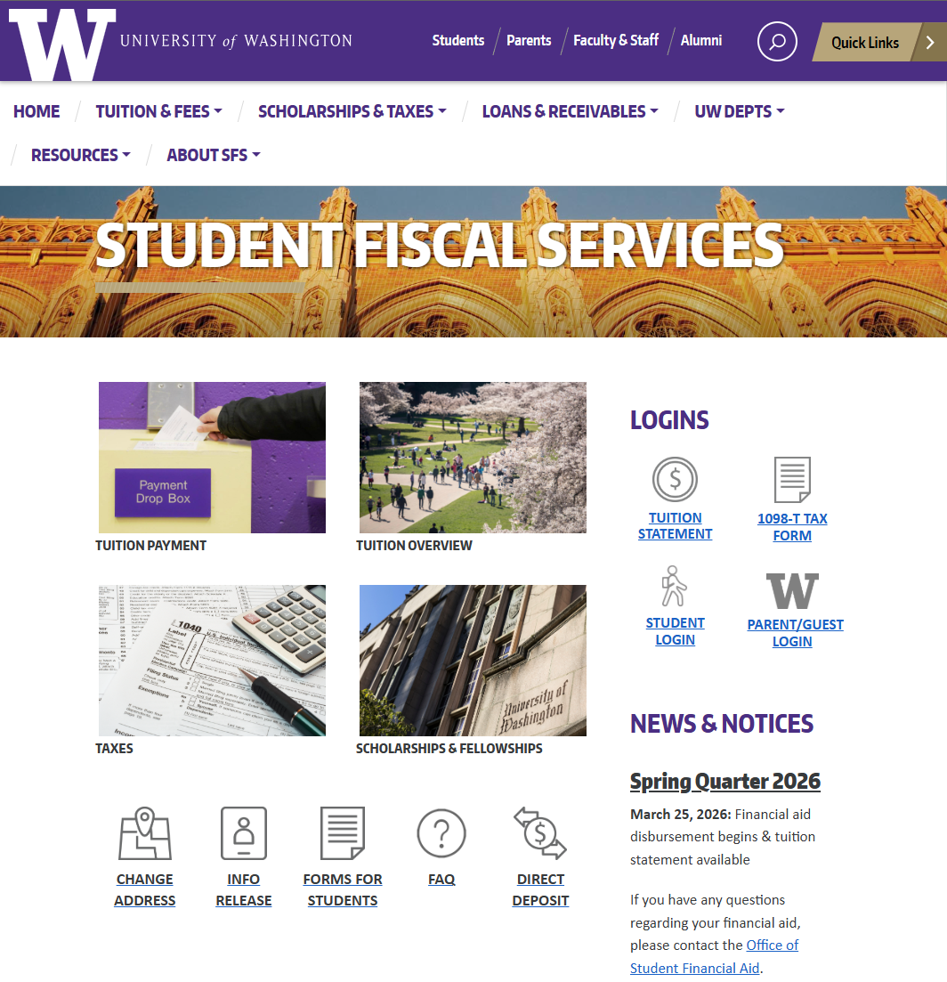
INFORMATION RELEASE – Pt. 4
To log in at any time, go to https://finance.uw.edu/sfs/
From the menu on the right, select PARENT/GUEST LOGIN
You can also search for:
Tuition Rates
Pay Tuition
Dropping Classes
Financial Aid
Working On Campus
Scholarship Database

Slide 9
INFORMATION RELEASE – Pt. 5
What are the downsides of the student giving you their MyUW login info, instead of granting Information Release?
You won’t receive an email each quarter when the bill is ready.
You won’t be able to contact our office if you have questions (FERPA requirement).

Slide 10
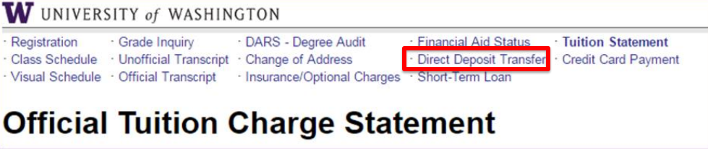
DIRECT DEPOSIT
FREE, FAST, SAFE
Get aid and refund disbursements faster – aid disburses in about three days!!
No check to lose, get stolen, or sent to the wrong address
Easy for student to sign up online through MyUW

Slide 11
PAY BY WEBCHECK – ONLINE BANK PAYMENT
FREE, FAST, SAFE
Payment shows up immediately
No checks lost/stolen in mail
Other options available
  By mail: Check
    University of Washington
    P.O. Box 3981
    Seattle, WA 98124-3981
  Online: Credit Card (+service fee)

Slide 12
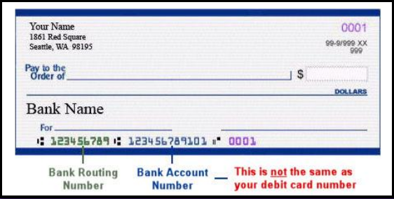
PAY BY WEBCHECK – ONLINE BANK PAYMENT
– contd.
These payments require your bank’s routing number and your bank account number
These numbers are available:
On a check
Online
Banking center
Calling the bank’s customer service line

Slide 13
INTERNATIONAL PAYMENTS
International Wire Payments
  Bank to bank wire payment method
  Email us at sfshelp@uw.edu for payment information
  Must include your student’s ID number
Flywire & Convera
  Access at https://finance.uw.edu/sfs/tuition-fees/pay-tuition-fees
  3rd Party Payment Partners
  Pay using either bank transfer, credit/debit cards, or e-payments
  Payment tracking
  Multilingual Support

Slide 14
FEES
Late Fees
  Tuition is due on the 3rd Friday of the Quarter!!!
  $50 to $249.99 → $50 fee
  $250 or more → $120 fee
Course Fees
Late Change Fee
U-Pass Fee
International Student Fee
Study Abroad Fees
Other Fees

Slide 15
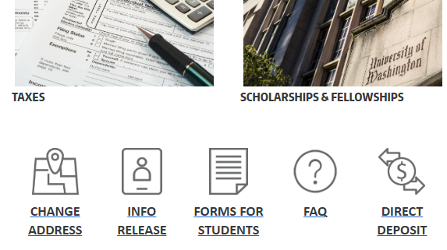
IMPORTANT INFORMATION – Pt.1
Change Address – Student should review on MyUW every quarter – https://finance.uw.edu/sfs/
  Keep information current – no lost or misrouted checks!
  Any mail will be sent to the address listed—including refunds and aid disbursements

Slide 16
IMPORTANT INFORMATION – Pt.2
Social Security Number (SSN)/Individual Taxpayer Number (ITIN)
Tax Reporting – Create Tax Forms (1042-S, 1098-T, etc.)
  US Resident Students - To report and create the 1098-T
  International Students - Used for 1042-S form to report U.S. scholarships received
WA 529 GET Payments – Families paying with WA529 GET must have an SSN on file for payments to process
May also impact processing of scholarships, loan, and/or military sponsor payments.
How to Update: https://www.uwb.edu/registrar/forms
  Then select “Student Record Change”
  In person at Summit Hall, Lower Level 9am to 4pm M-F
    *Bring physical card or image

Slide 17
IMPORTANT INFORMATION – Pt.3
Contact SFS: sfshelp@uw.edu | (206) 543-4694
  Aid: Generally, tuition and fees are paid first from any scholarships, outside sponsors, grants or loans received.
  Account Balance: It is valuable to check the student account balance throughout the quarter as additional fees or aid could appear after the initial billing. Example: Late Change Fee.
  Important Dates: Make sure your student is aware of deadlines for class or credit changes without a penalty.
  Taxes: Opt-out of the paper form → your student can print the 1098-T online to get it earlier and more efficiently.
Contact the IRS at https://www.irs.gov/ to ask about tax credits.

Slide 18
STUDENT FINANCIAL AID
UW Bothell: uwbfaid@uw.edu | (425) 352-5240
  FAFSA must be completed each year
    To complete go to https://studentaid.gov/h/apply-for-aid/fafsa
  Offer is made by the Financial Aid Office who handles applications, determines eligibility, and makes awards
    Student must accept aid and sign the appropriate promissory notes
  Parent applies and signs the Plus Loan Master Promissory Note
    To apply/sign go to https://studentaid.gov/plus-app/parent/landing

Slide 19
NON-UW SCHOLARSHIPS
Students need to report all scholarships to the Office of Student Financial Aid (OSFA) if they were not already reported on their FAFSA
Not reporting all scholarships can impact a student’s financial aid award and, in some cases, may require them to return some of their financial aid money
  uwbfaid@uw.edu (UW Bothell)

Slide 20
NON-UW SCHOLARSHIPS – contd.
Inform any scholarship provider to send funds to this address:
  University of Washington
  PO Box 24967
  Seattle, WA 98124-0967
Be sure they include the following:
  Student Name
  Student ID Number
  Academic Quarter

Slide 21


WA529 – WASHINGTON EDUCATION SAVINGS PLANS
WA529 GET – https://529.wa.gov/get
  Request in Fall for all three quarters or each quarter separately
  Questions about how much or how many units – contact the WA529 GET
  UW housing charges can be paid with GET, please contact HFS to coordinate this payment with our office
WA529 Invest - https://529invest.wa.gov/
  Contact WA 529 for guidance on how to issue funds to UW
    Best resource for disbursement questions
  Payments by check must include student name and ID number and be sent to:
    University of Washington
    PO Box 3981
    Seattle, WA 98124-3981

Slide 22
UW BOTHELL
Cashier Office
  UW Bothell: uwbcash@uw.edu | (425) 352-3246
    Tuition statement, aid disbursement
Housing
  UW Bothell: uwbhousing@uw.edu | (425) 352-3544
    Housing charges
Financial Aid
  UW Bothell: uwbfaid@uw.edu | (425) 352-5240
    Aid eligibility and awarding, FAFSA processing, aid counseling

Slide 23
VETERANS AND ROTC
Office of Veteran & Military Educational Benefits
  Website: https://www.uwb.edu/financial-aid/veteran-military-educational-benefits
  Contact: uwbvasco@uw.edu| (425) 352-5240
ROTC (Reserve Officers’ Training Corps)
  Contact the Seattle Campus ROTC units for all scholarship queries.
    Army (206) 543-9010
    Navy (206) 543-0170
    Air Force (206) 543-2360

Slide 24
ACTION STEPS FOR PARENTS & STUDENTS
Tuition is due the 3rd Friday of every quarter
Pay by Webcheck – Online Bank Payment
  Pay your tuition online with your bank account via MyUW.
Information Release
  Authorize others to view your tuition statement and contact our office.
Direct Deposit
  Get any aid or refund disbursements faster, easier and more securely.
Change Address
  Update it on MyUW every quarter

Slide 25
QUESTIONS?
Email - sfshelp@uw.edu
Phone - (206) 543-4694
Live Chat/Website - https://finance.uw.edu/sfs/

