Slide 1

Your IAS Portfolio(s)
This presentation is available on the IAS web page. Look under "IAS Degree Portfolio."

Slide 2
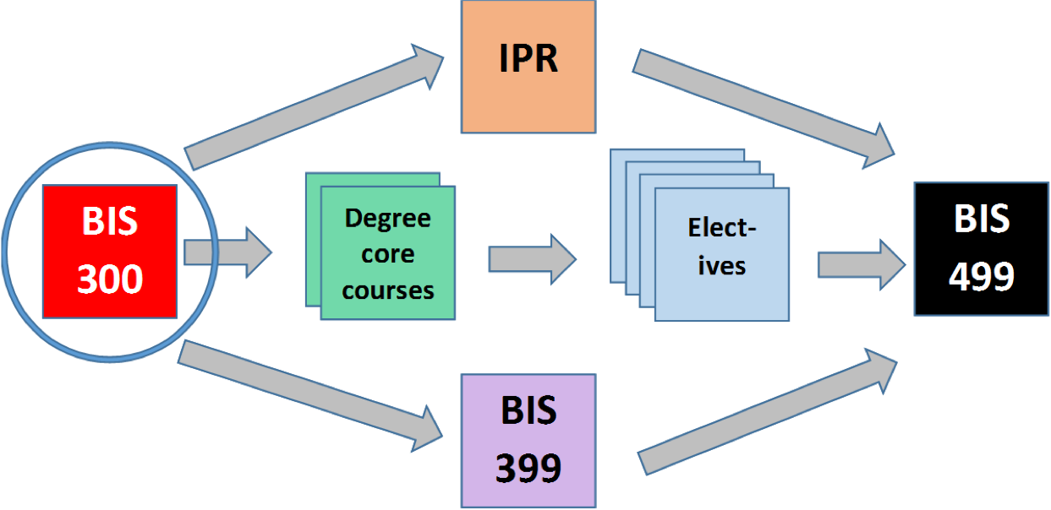
Portfolio-based learning in IAS is central to... (1 of 3)
1. …BIS 300, where you start to build an archive of your work and make a course portfolio using your personal Google drive, where you can store your archive.

Slide 3
Portfolio-based learning in IAS is central to... (2 of 3)
2. …other courses in IAS and at the UW, where you build your archive. (Note: Your archive can and should include artifacts from co- and extra-curricular activities.)

Slide 4
Portfolio-based learning in IAS is central to... (3 of 3)
3. …BIS 499, the Portfolio Capstone course where you draw from your archive to create a learning/professional portfolio.

Slide 5
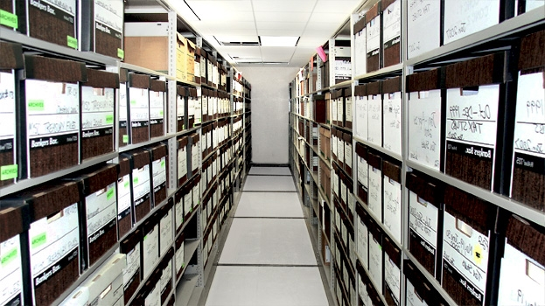
So I’m in BIS 300, how do I get started?
Some Basic Terms
An "artifact" is anything you can store.
An "archive" is a collection of all your artifacts.

Slide 6
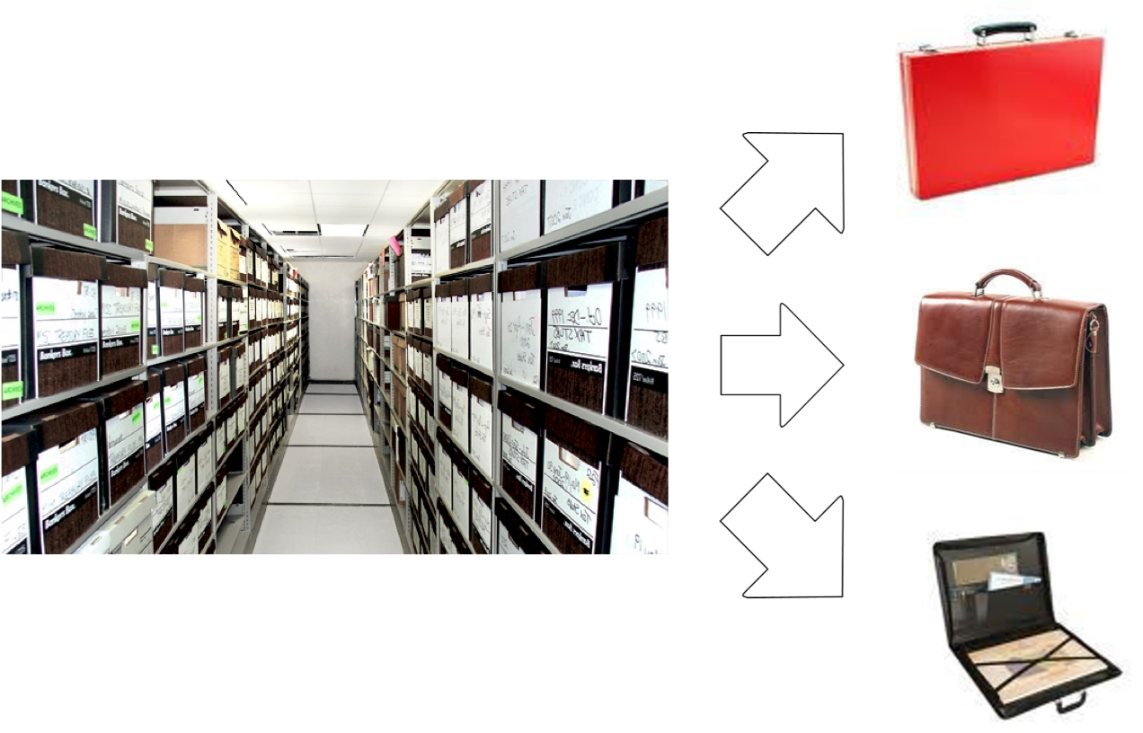
A "portfolio" contains a limited number of artifacts drawn from your archive.

Slide 7
A portfolio is...
A meaningful selection of your artifacts.
Thoughtfully organized to provide evidence of your achievements and abilities.
Introduced by an essay that frames the significance of those artifacts.

Slide 8
Portfolios have audiences...
Your professor or academic program
Potential employers
Potential graduate or professional school admissions committees
Your friends, family, and you

Slide 9
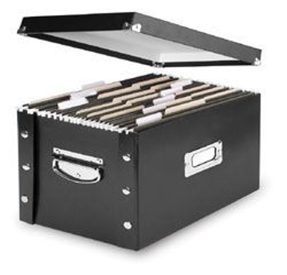
Artifacts to include in your archive...
Course papers and projects, exams, presentation materials
Course syllabi and assignments
Videotapes of performances or presentations
Photographs of posters or art pieces
Written comments by instructors or peers on presentations, performances, or group work

Slide 10
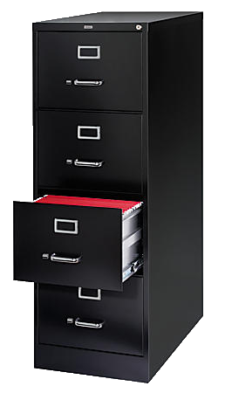
Your archive could also include...
Recommendation letters
Awards and award letters
Web pages you contributed to
Material from your work life
Material from work with community or volunteer organizations

Slide 11
How to build your archive...
Save everything. Even less-than-satisfactory assignments can be evidence of your progress. Get commented versions of papers back whenever possible.
Look for ways to record performances, presentations, and collaborative work - activities that don't produce easily-saved documents.
When you can, save in an electronic format. Scan things that you have only paper copies of. Take photos.
Use your personal Google drive to keep your stuff in one place – it's easy to lose documents that are on thumb drives or different computers.

Slide 12
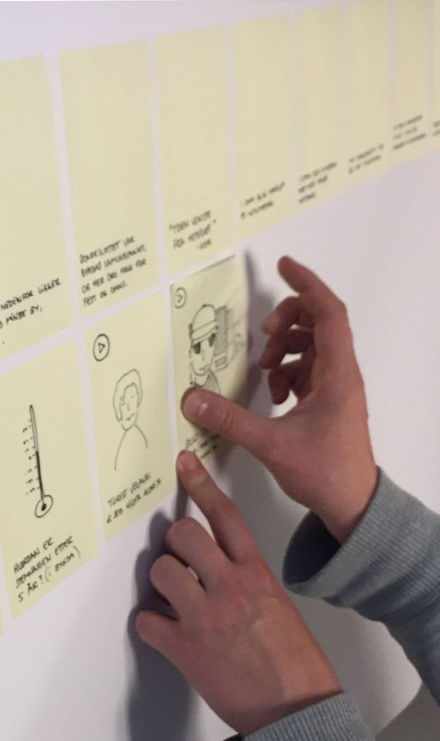
How to make a portfolio - first steps...
Review the artifacts in your archive. What do they show?
Think about who your audience is.
Decide what evidence-based claims about your own abilities you want to make.
Remember: You're not just giving people a lot of stuff. You're giving them a story. Sometimes less is more. Almost always, in fact.

Slide 13
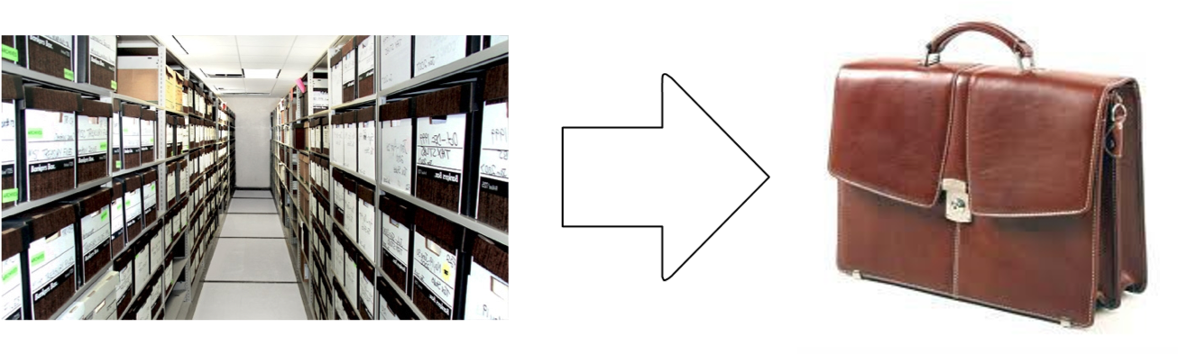
How to make a portfolio: further steps...
4. Select artifacts that you can use to provide evidence for your story about your abilities.
5. Organize those artifacts in persuasive ways.
6. Write an introductory essay in which you state your claims, refer to the artifacts as evidence, and explain why and how those artifacts support your claims.
Making a good portfolio takes practice...

Slide 14
Resources
Sample IAS Student Capstone Portfolios
The UW Bothell Writing and Communication Center
The UW Bothell Career Services
Your IAS Faculty
Google Drive
Me: Burgett@uw.edu

