Slide 1
Getting Great Letters of Recommendation Workshop
Presenters:
Kim Wilson, Career Center
Natalia Dyba, Merit Scholarships
Wednesday, October 30, 3:30-5:00pm
UW1-103
UW BOTHELL OFFICE OF MERIT SCHOLARSHIPS, FELLOWSHIPS AND AWARDS AND THE CAREER CENTER
UW1-161 | meritscholarships@uwb.edu | 425.352.3185
Notes:
Time: 5 min total for introductions and agenda

Slide 2
Agenda
Overview of letters of recommendation
Good vs. great letters of recommendation
Tips for getting great letters
Advice from faculty panel
Q&A
Notes:
Lead: KIM

Slide 3
Overview
What purpose do letters of recommendation serve?
Types of recommendations
Foundation = relationships built over time
Notes:
Lead: KIM
* If group is really experienced with letters of recommendation, don’t need to cover the basics in much detail*
Time: 5-10 min max
Situations that typically require letters of recommendation:
 Scholarship or fellowship applications
 Graduate school applications
 Research opportunity applications
 Job or internship applications
 Study abroad applications
Some programs require letters to address specific points:
 The letter should address the specific nature and intent of the program you’re applying to
 Mary Gates Leadership Scholarship mentor letter: Show a strong sense of commitment and an ongoing connection to the student as they proceed
 Graduate school: Give examples illustrating how the student has made a good choice in applying to this school or program
 Study abroad: Give examples of how prior experience has prepared the student to be successful abroad

Slide 4
Sample Letters
Review the good and outstanding letters.
Discuss:
What makes the outstanding letter more effective?
Notes:
Lead: NATALIA
Time for review and small group discussion: 5 min
Reporting out: 2 min
In small groups, review sample letters. Which is better? What makes it more effective?
https://docs.google.com/viewer?a=v&q=cache:4NKJLzXJTnkJ:www-verimag.imag.fr/~plafourc/DIVERS/sample_letter.pdf+&hl=en&gl=us&pid=bl&srcid=ADGEESj-rgXMOMmjxkKUDcOsMYlWS-I5AOAeaYdIucQGNsYkITd20LyuiBijg3LtsC0XgKm3u5Iv4UfvwuHkq5KVXlUrhbAT44Bo5EH3fCRWEHvwdtI_2toNsD2OrHgK6022JYMJ8GJn&sig=AHIEtbRto3eZ6QMfShD4RUji4WgNKF5prA

Slide 5
Good Letters vs. Great Letters
Indicate strong academic performance
List positive qualities of applicant
Make general recommendations
Demonstrate that the writer knows the student well
Indicate understanding of the letter’s purpose
Give specific examples of the student skills and experiences relevant to the opportunity
Notes:
Lead: NATALIA
Time: 5 min
A great recommendation letter will:
 Demonstrate that the writer knows the student well
 Indicate understanding of the letter’s purpose
 Give specific examples of why the student is a good candidate
 Give a clear sense that the letter is coming from the right person based on the writer’s background and the student’s field of interest
 Provide specific examples of attributes and experiences that the student will bring to the experience

Slide 6
Tips for Obtaining Great Letters
Network to build strong relationships
Pick the most strategic recommenders:
Academic vs. professional references
Alignment with program/scholarship goals
Give advance notice
Notes:
Lead: NATALIA
A good reference: A professor in whose class you earned a good grade or an employer who has commented positively about your work.
A great reference: In addition to the above, they can comment on your personality and passions.
Academic Reference
Consider any Professor:
who has seen your best academic work
that you engaged with in a quarter-long special topics or research project
Work Reference
Consider any Employer:
where you received promotions
where you completed any special projects
where you can qualify or quantify your contribution to the organization
that you left the organization on good terms
with whom you still communicate

Slide 7
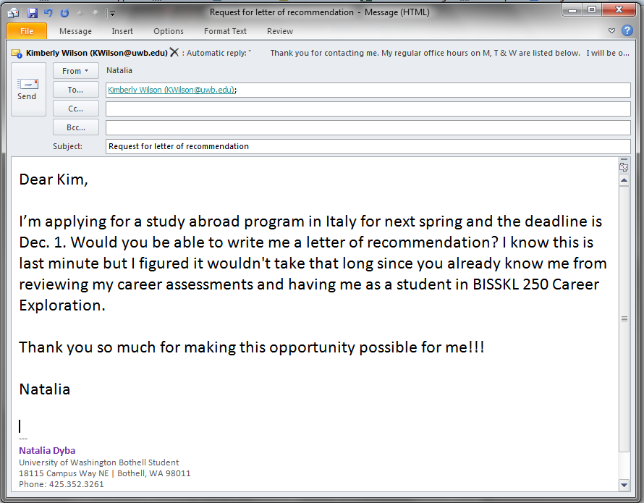
Requesting the Letter
What’s wrong with this email?
Notes:
Lead: NATALIA
Time for small group discussion: 3 min
Give time for small group discussion:
- What specific things could you do to improve this email request?
Transition to KIM
Mention email conversation with faculty member Julie Shayne as the idea for this email

Slide 8
Tips for Obtaining Great Letters
When making a letter of recommendation request, include:
Description of program/job/scholarship
Exact wording of what should be covered in the letter -> skills, qualifications and accomplishments to be highlighted
List of specific, relevant experience: class projects, research, papers and grades for faculty; responsibilities and accomplishments for supervisors
Resume, cover letter or personal statement used to apply
Deadline and specific submission instructions
Name and address of letter recipient
Notes:
Lead: KIM
Time: 15 min for entire tips section
Draw on small groups’ input to go over this list.

Slide 9
Tips for Obtaining Great Letters
Communicate via one email trail
Be timely and responsive to additional information requests from your reference
Show thanks!
Keep in touch
Notes:
Lead: KIM
Why is it important to maintain relationships with potential recommenders?
 Help the recommender get to know you even better
 Interests, studies, research, common interests
 You might need their help again someday!
 Other scholarships, graduate school, professional references
Additional suggestions for keeping in touch (time-permitting):
How can you keep the door open?
 Follow up with the recommender each time
 Write to thank the person for meeting with you
 Write a thank you card for recommendations
 Send postcards, emails, or photos as updates
For alumni of programs:
 Intentional Facebook or Twitter posts, help with advertisement of the programs with quotes
 Call to chat
 Stop by to give an update on your activities

Slide 10
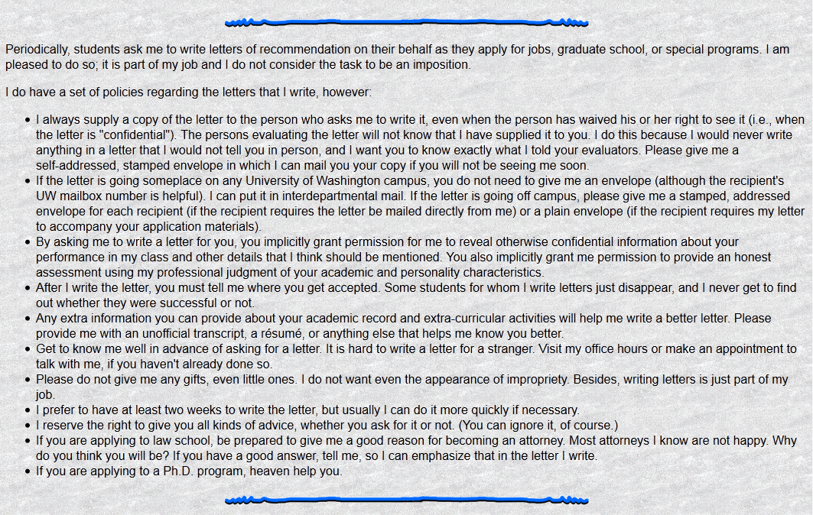
To illustrate…
Notes:
Lead: DAVID
Time: 5 min to highlight reason for this webpage and main points

Slide 11
Faculty Panel
Susan Gibson, Business
Kim Wilson, IAS
Notes:
Total panel time: 25 min
Questions:
How many letters of recommendation do you write per quarter? Per year?
How many hours does it take to write a letter?
How much advance notice do you prefer to have?
What’s your pet peeve when being asked to write a letter of reference?
What’s one piece of advice that you want to leave the audience with?

Slide 12
Questions?

